Slide 1
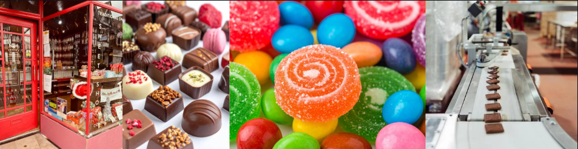

Section A: Current trends in the consumption of confectionery and biscuits

Slide 2
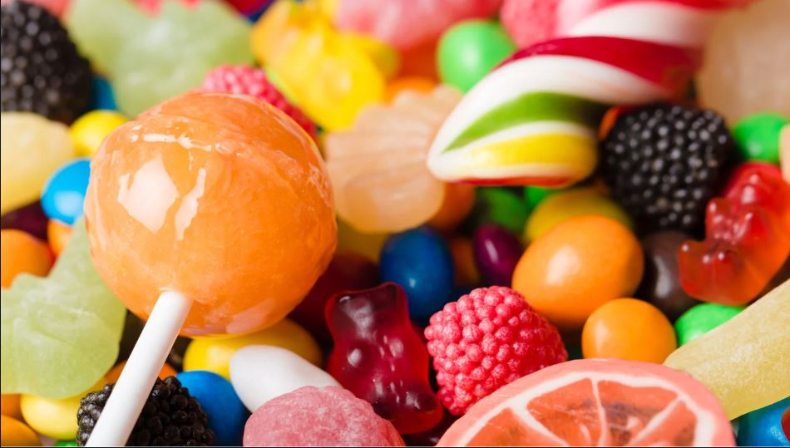
SECTION A: Links to the pre-release
This year the context is the confectionery (including biscuits) industry, and the small, national, and international businesses operating in this market
Current trends in the consumption of confectionery and biscuits

Slide 3


Slide 4


Starter – trends – can you spot the fakes?
Which of the following are REAL trends in the biscuit market and which are FAKE?
Healthier biscuits (snacking with nutrition in mind)
New innovative flavours (For example: Pistachio and Dubai style cream Fox’s biscuits)
AI generated limited editions (e.g. Mint and Mango crunch)
Eating biscuits on-the-go at least once a week (e.g. 25-34 age group)
Biscuits that boost brain power and moods (e.g. choco-chilli)
Personalised horoscope biscuits (e.g. Pisces sea salt and blueberries – ocean dream)
See next slide for images to help you make up your mind!

Slide 5
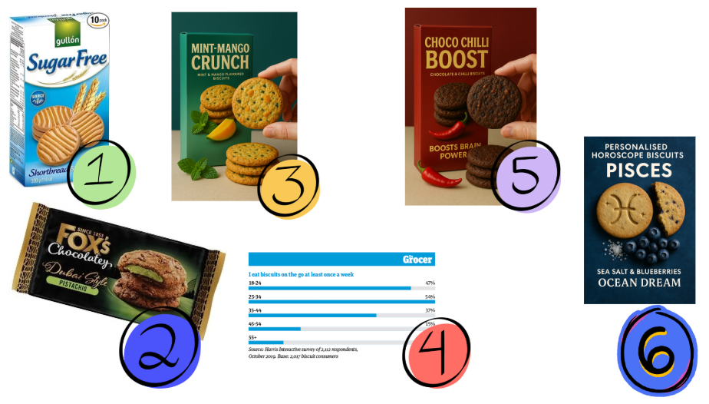

Slide 6
Answers to the starter activity…
How many did you spot…here come the answers (see next slide)

Slide 7
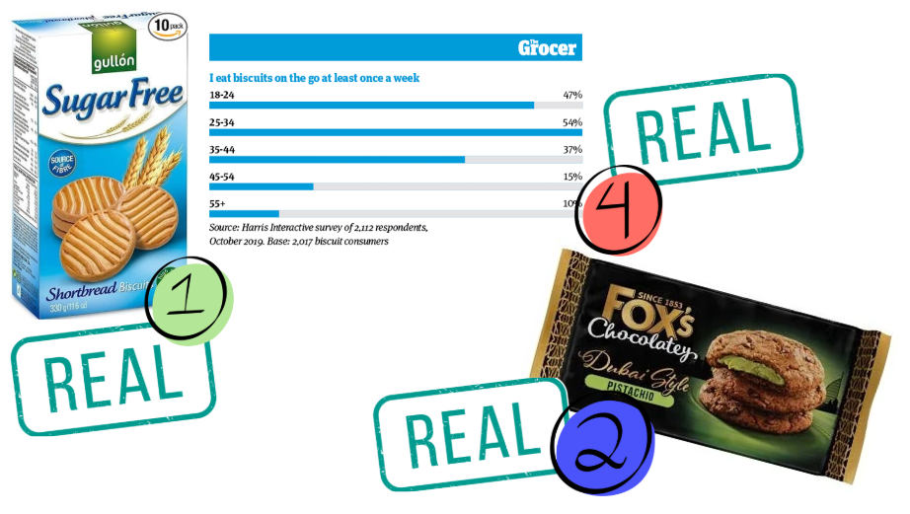

Slide 8
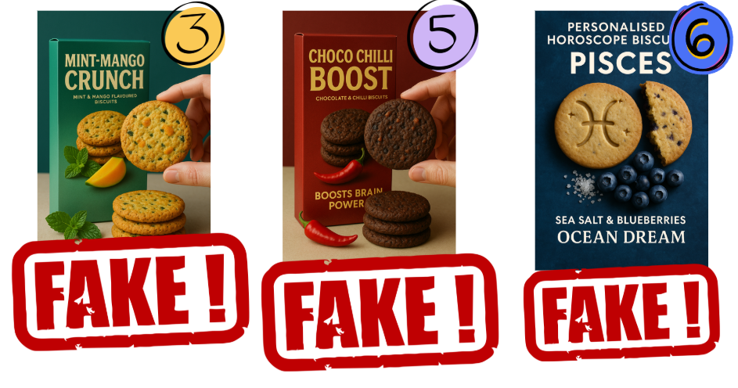

Slide 9
Links to syllabus
1.1.1 Dynamic markets
1.1.2 Market research
1.2.1 Demand
1.3.1 Product / service design
1.3.2 Branding and promotion
1.3.3 Pricing strategies
2.2.1 Sales Forecasting
4.2.1 Conditions that prompt trade
4.3.3 Cultural / social factors (covered in section E)

Slide 10
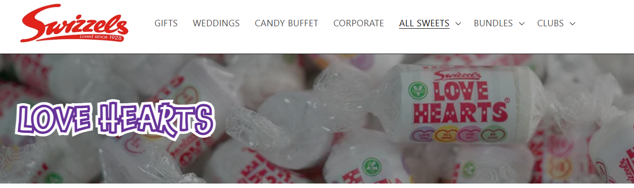
Before we start
Confectionery means; candies, gummies, pastels, chocolate and in this context biscuits
Confectionery is sold by manufacturers either wholesale to retailers or direct from their own websites. Not all have both.
So for example Swizzles make love hearts and they sell wholesale to retailers and direct to customers, but if you wanted to buy a MARS bar you would purchase it only from a retailer

Slide 11
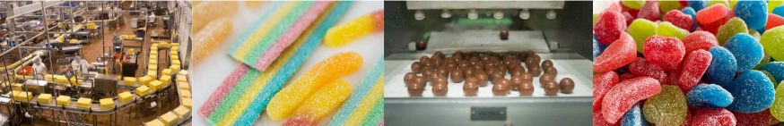
1.1.1 Dynamic markets

Slide 12
1.1.1 Dynamic markets
a) Mass markets and niche markets:
  characteristics
  market size and market share
  brands
b) Dynamic markets:
  online retailing
  how markets change
  innovation and market growth
  adapting to change
c) How competition affects the market
d) The difference between risk and uncertainty

Slide 13
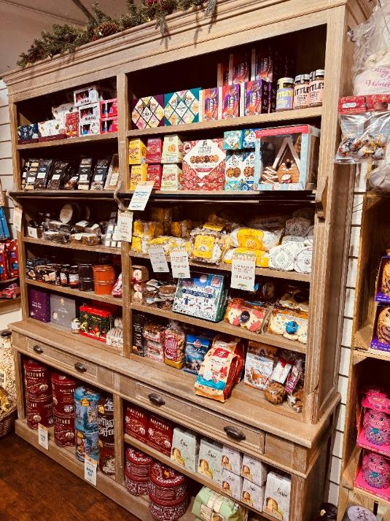
Characteristics of the confectionery industry
The confectionery industry is all about creating sweet treats people love to grab on the go
Strong brands, eye-catching packaging, and seasonal favourites play a big role in sales
It’s a competitive market, so companies constantly develop new flavours and products to keep up with changing tastes
80% of our purchasing decisions are made at point-of-sale (we grab some chewing gum)

Slide 14
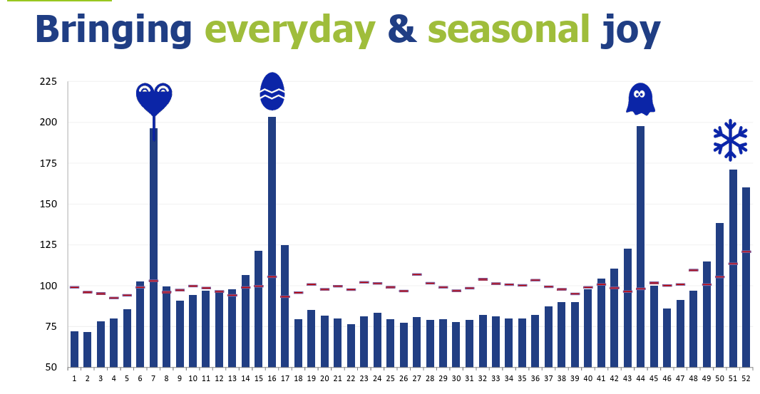
Confectionery is a very seasonal industry
Task:
What 3 conclusions can you make from this graph?
Notes:
*Source – this chart is in the pack in the section called USEFUL DOCUMENTS
Suggestions:
That there are 4 main selling events of the year and so this will impact production, stock control, revenue and marketing
That production would be concentrated in the summer months to prepare for the increase in demand at Halloween (stock levels)
That promotional activity can be closely targeted to these events to maximise profits and sales

Slide 15
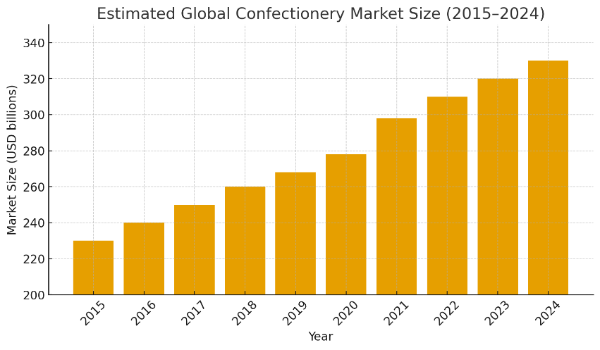
Market size of the confectionery industry
The global confectionery market is worth $284 billion, growing steadily at around 2.2% annually
Strong demand for chocolate, sugar confectionery, and snacks continues to expand worldwide
With rising consumer demand, innovation, and wider retail reach, the sector remains a dynamic, high-value market full of growth opportunities
Task: Make one conclusion from reading this graph
Notes:
Suggested answer:
The global confectionery market size is growing steadily year on year, might be wise to invest in confectionery companies. 10 years of data show steady growth so lower risk for investors.
Source: https://www.globenewswire.com/news-release/2025/07/15/3115814/0/en/Confectionary-Market-Size-to-Reach-USD-467-81-Billion-by-2034-Fueled-by-Health-Conscious-Trends-and-Innovation.html (Note there are lots of different estimates on the Internet and this is probably the best one to use).
Additional data:
These figures represent estimated global confectionery sales, not total company sales. They show how much each company earns worldwide from chocolate, candy, and sweet snacks.
Mars leads with around $45 billion
Mondelēz follows at $36 billion, strengthened by Cadbury and Toblerone
Ferrero and Hershey remain major global competitors
Lindt, Haribo, and Perfetti Van Melle dominate premium and sugar confectionery segments
These companies form the oligopoly controlling most global confectionery production.

Slide 16








Is there an oligopoly in the confectionery industry?
In most countries, the confectionery industry functions as an oligopoly, meaning a small number of large firms dominate market share. The key players vary slightly by region, but globally the main businesses include:

Slide 17
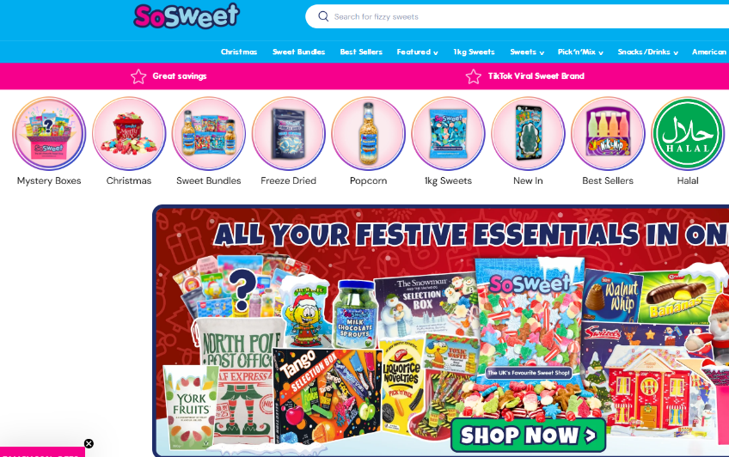
Online retailing in the confectionery industry
Online retailing in the confectionery industry makes it easy for customers to buy sweets from home.
Brands and retailers sell through websites and apps – which makes up 37% of all retail confectionery sales (UK)
Many manufacturers sell through 3rd party retails e.g. SoSweet
Name 3 brands that only sell through retailers (P = Place of marketing mix)?
Notes:
Suggested answers:
Mars
Haribo
Perfetti Van Melle they make mentps and Chupa chups
At time of writing

Slide 18


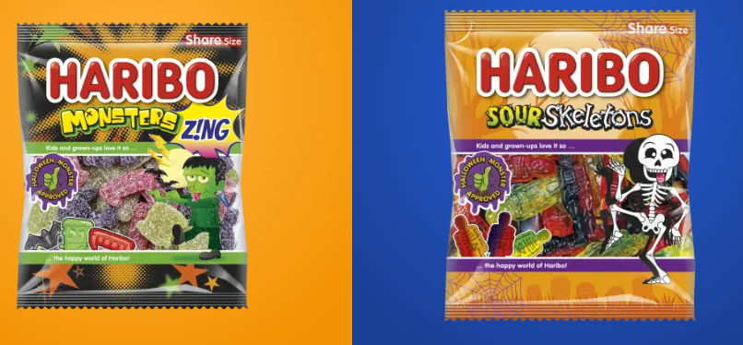
How markets are changing in the confectionery industry
The confectionery market is changing as customers want healthier choices, new flavours, and more sustainable products
Seasonal trends are also influencing demand, encouraging brands to update their products to match changing customs
For example: In the UK giving out sweets at Halloween has become ‘the norm’, so companies such as Haribo have developed products to meet this new demand

Slide 19

INNOVATION IN THE CONFECTIONERY INDUSTRY
Innovation in the confectionery industry includes creating healthier recipes, using plant-based ingredients, and developing exciting new textures and flavours
Businesses are using new technology to improve production and packaging
Eco-friendly materials, personalised products, and unique limited-edition items help companies stay competitive and meet growing customer interest

Slide 20
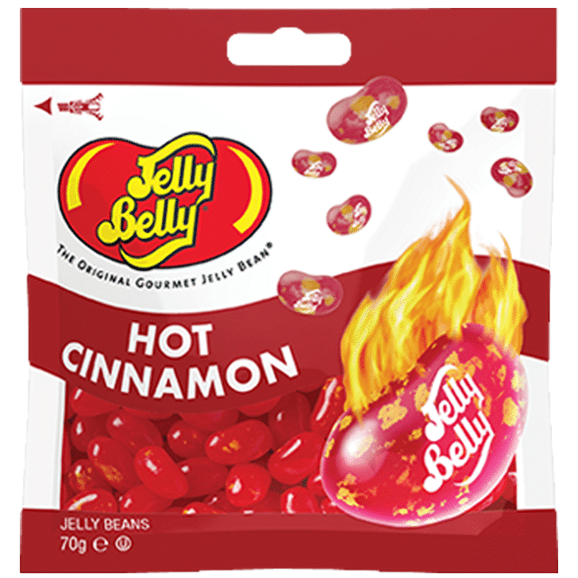
Market growth in the confectionery industry
Non-chocolate confectionery (like sweets, gummies, chews) is growing faster than the overall market, expanding at about 5.5%
There are 5 ‘candy’ types; gummies, chewy, hard, lollipop and liquorice
Classic fruit flavours still have 42% share of the market
Spicy, mystery and sour flavours are more popular with Gen Z

Slide 21
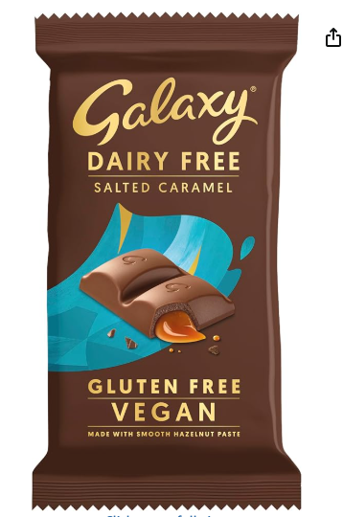
Adapting to change in the confectionery industry
Chocolate is still the largest selling product in the confectionery industry
Change in the industry is being driven by consumer trends in health-conscious snacking, plant based ingredients and new textures and formats
Brands that embrace flavour experimentation and seasonal relevance, will come out on top
Notes:
Source: https://www.confectionerynews.com/Article/2025/10/10/confectionery-market-to-hit-278b-by-2032-as-candy-sales-surge/?utm_source=chatgpt.com

Slide 22
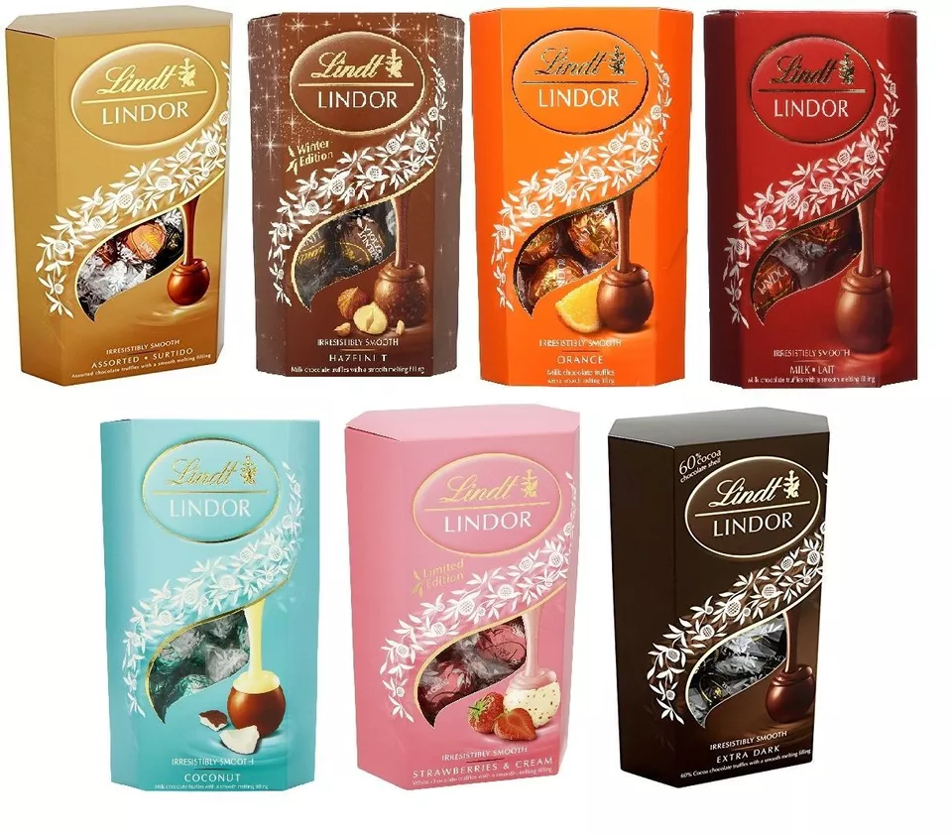
How competition affects the market in the confectionery industry
Competition in the confectionery industry influences pricing strategies, product differentiation, and market positioning
Companies face pressure to innovate, manage costs, and strengthen their brands
Intense rivalry increases consumer choice and drives efficiency, while encouraging businesses to adapt quickly to changing demand and maintain competitive advantage in the market
For example the growth of the Lindor brand with more varieties to serve more markets

Slide 23
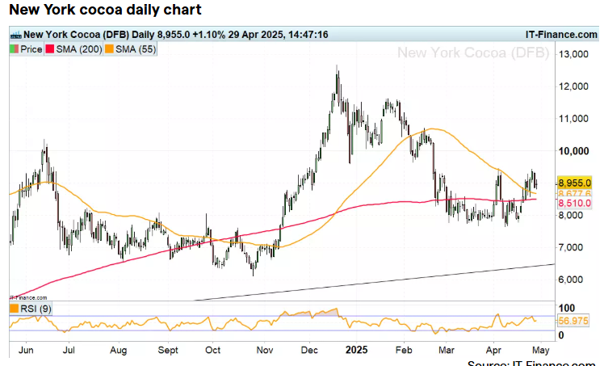
The difference between risk and uncertainty in the confectionery industry
In the confectionery industry, risk refers to quantifiable events firms can anticipate, such as projected sales or raw material cost fluctuations
Uncertainty happens when external factors are unpredictable, like sudden regulatory changes or disruptive consumer trends
Managing both is essential for strategic decision-making and maintaining completive advantage
Fluctuations in the price of cocoa this year – is this risk or uncertainty?
Notes:
Answer:
Fluctuation of the price of cocoa is a known risk as the fluctuations have years of historical data to show those patterns

Slide 24

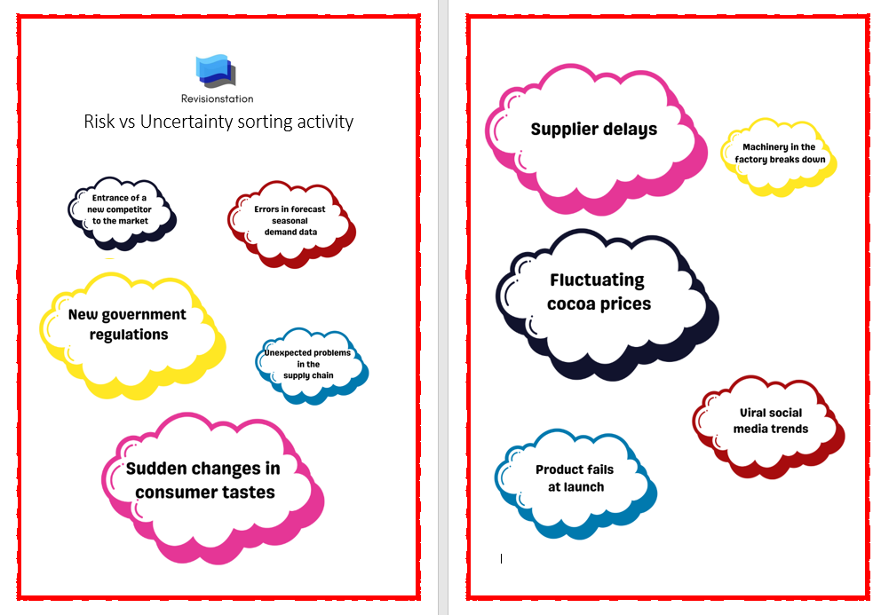

Risk vs Uncertainty sorting activity
Notes:
Author’s Note: This activity is also available as a printable PDF in the pack (in SECTION A),
Also if you open the Word doc version you should be able to move them round the page.
This could also be offered as a cut and sort activity if you need a group brain break but want to stay on topic. It will help any student who is unclear on the difference between risk and uncertainty.
This will not appear in the free sample

Slide 25
1.1.2 Market research

Slide 26
1.1.2 Market research
a) Product and market orientation
b) Primary and secondary market research data (quantitative and qualitative) used to:
  identify and anticipate customer needs and wants
  quantify likely demand
  gain insight into consumer behaviour
c) Limitations of market research, sample size and bias
d) Use of ICT to support market research:
  websites
  social networking
  databases
e) Market segmentation

Slide 27

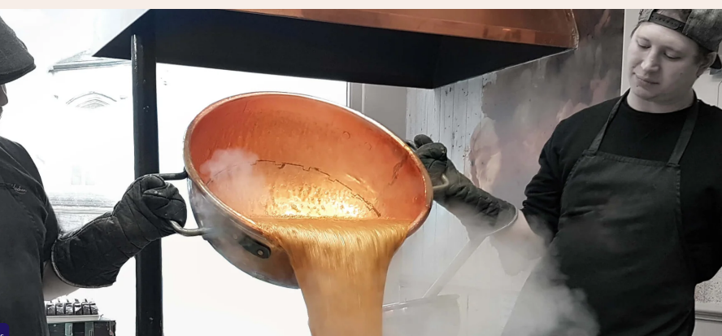

Product orientation in the confectionery industry
Production orientation means that decisions about what types of sweets to produce are influenced by what the company can produce, rather than based on results from market research
Businesses following this strategy may be limited by their production capacity or lack the equipment and R&D capability to produce anything else
Fudge making process by hand in the fudge kitchen. New products will be limited to what they can produce by this method.

Slide 28
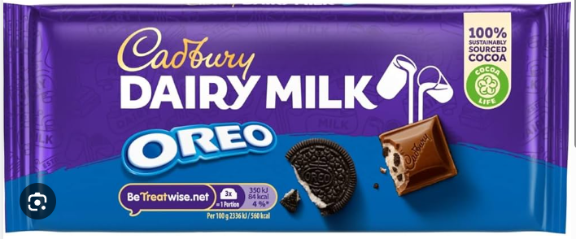
Market orientation in the confectionery industry
Market orientation means that companies will base their product range decisions on what consumer needs are and the results of their market research will be very important
This will allow them to satisfy customer wants and needs and to respond quickly to changing trends
Customers surveyed wanted a chocolate bar that tasted like a cookie and had a crumbly texture.
Cadbury (Mondelez) produced this variant. Note the sustainably sourced cocoa tab to achieve two goals in one.

Slide 29
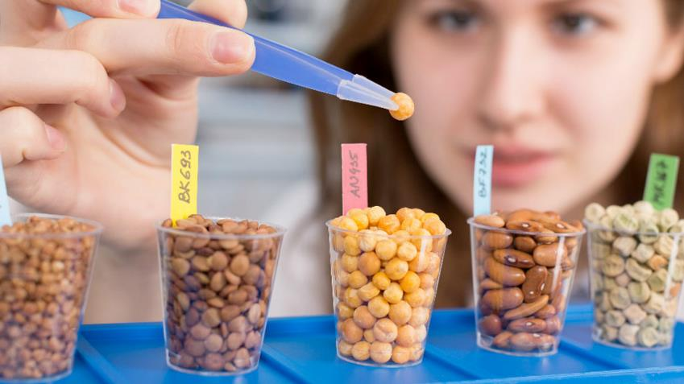
Primary market research data in the confectionery industry
Customer surveys e.g. asking what size product they prefer
Product taste tests e.g. feedback on texture or flavours
Focus groups e.g. customer attitudes towards new products
Product trials / samples e.g. gathering data on how likely customers are to make a purchase after trying a sample
What kind of data would ‘observation in confectionery stores’ produce?
Notes:
Suggested answer:
Primary data collected first-hand and specific to the research purpose (whatever the company wanted to research, rather than just general data)
Quantitative data – time spent by customers looking at displays or choosing pick n mix – to allow patterns or trends to be measured
Qualitative data – where customers hesitate or put products back on the shelf – to explain customer behaviour

Slide 30
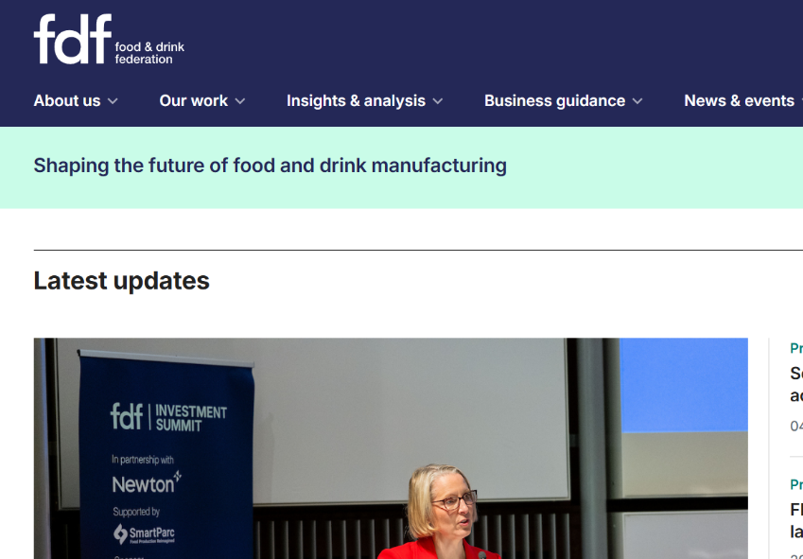
Secondary market research data in the confectionery industry
Demographic census data
Industry reports e.g. Mintel report into confectionery trends
Government statistics e.g. on household spending on treats and snacks
Trade associations e.g. FDF Food and drink federation
Company reports e.g. Mondelez annual report
What information could be gained from looking at a confectionery competitor’s website?

Slide 31

Limitations of market research, sample size and bias
Market research may be limited by small sample sizes that reduce reliability and make findings less representative of the target market
Bias can also distort results if questions are leading or if respondents are untruthful, causing inaccurate insights and poor business decision-making
What is ‘bias’?
Notes:
Suggested answer:
In market research, bias is anything that distorts the results so they do not accurately represent the target market. Bias in market research occurs when the way data is collected, sampled, or interpreted leads to results that are inaccurate or misleading.

Slide 32
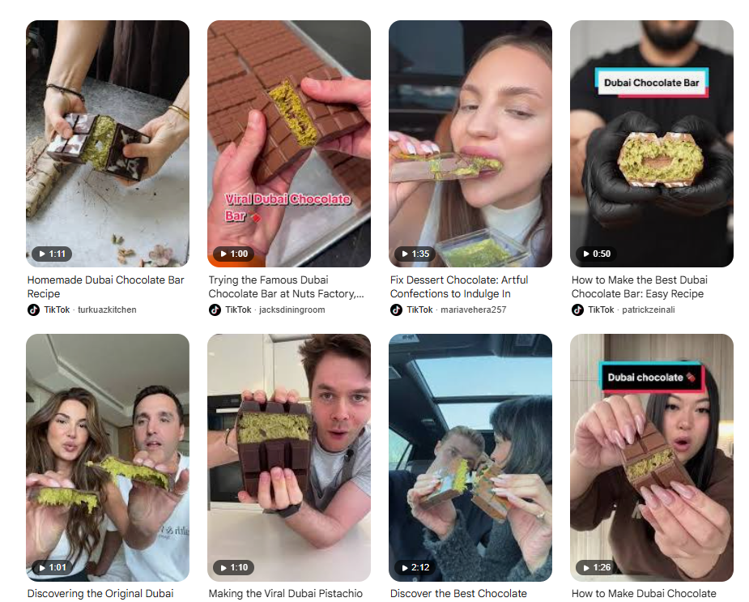
Uses of ICT to support market research in the confectionery industry
Online surveys and questionnaires e.g. pop up / email after sale
Social media analysis e.g. track trends and identify popular confectionery products
EPOS data e.g. consumer buying patterns at the supermarket till
Website analysis e.g. most popular time of day for sales
How could AI tools be used to support MR in the confectionery industry?
Notes:
Suggested answers (other answers are possible):
To analyse the data – large amounts of data can be summarised in seconds – to help a confectionery business identify trends such as vegan sweets
To analyse social media – to identify customer opinions about brands
To predict the future – to use historical data to forecast demand, which reduces the risk of launching an unsuccessful product
To reduce bias – by reducing human bias in the analysis of the data
Author Note: unlikely to get a specific question on AI (but not impossible)– but a useful argument in case there is a question on the use of ICT

Slide 33
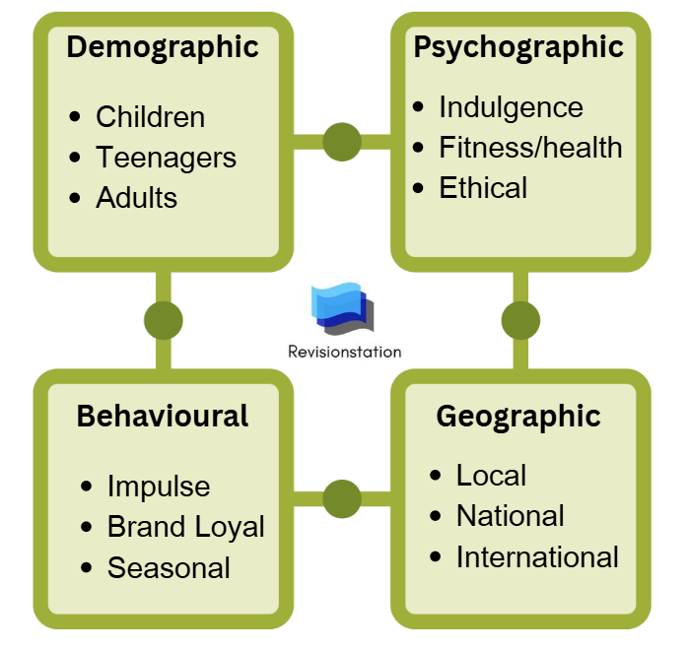
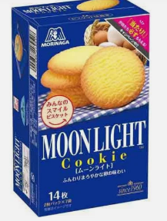
Activity: Market segmentation in the confectionery industry
For each of these segments suggest a suitable product
E.g. International, these Moonlight cookies are very popular in Japan
Notes:
Author’s note:
This is available as a PDF version in the pack in SECTION A

Slide 34
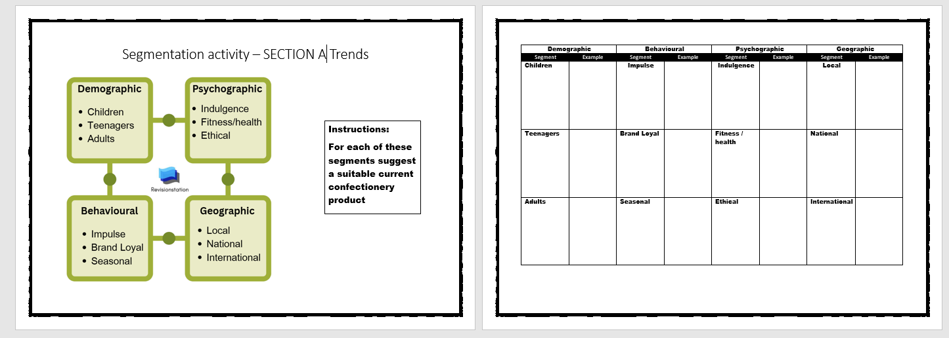
This is a screen shot of the PDF in the pack (in section A) which shows the instructions and the answer sheet. Please note this PDF will not appear in the free sample.

Slide 35
1.2.1 Demand

Slide 36
1.2.1 Demand
a) Factors leading to a change in demand:
  changes in the prices of substitutes
  complementary goods
  changes in consumer incomes
  fashions, tastes and preferences
  advertising and branding
  demographics
  external shocks
  seasonality

Slide 37
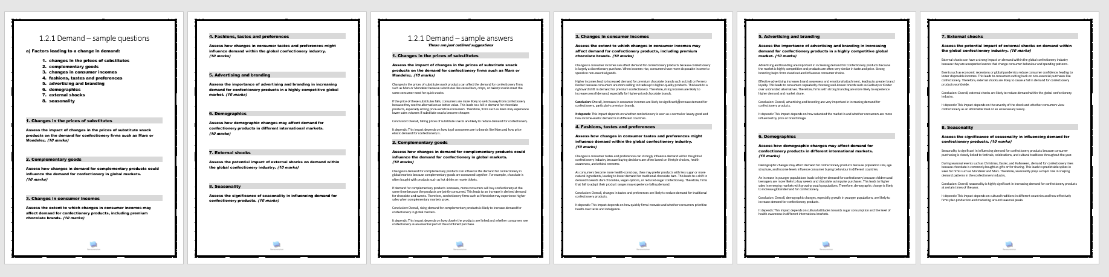
Sample questions
The sample questions coming up in this section are also available in a PDF in the pack. This is where all the outlines are for sample answers.
Notes:
Author’s note: All of these questions and suggested answers in SECTION A TRENDS In the pack. (This may not be in the sample)

Slide 38

Factors leading to a change in demand: Changes in prices of substitutes in the confectionery industry
An increase in the price of substitute products can raise demand, as consumers switch to relatively cheaper alternatives
However, falling substitute prices may reduce demand due to higher price competitiveness and greater perceived value for consumers
Try the sample question
Notes:
Answers in the PDF in the pack in SECTION A TRENDS

Slide 39
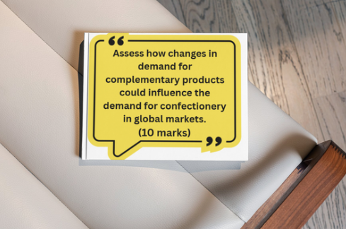
Factors leading to a change in demand: Complementary goods in the confectionery industry
Demand for a product may change due to fluctuations in demand or price of complementary goods
When complementary goods are jointly consumed, a rise in demand for one increases demand for the other
Try the sample question
Notes:
Answers in the PDF in the pack in SECTION A TRENDS

Slide 40
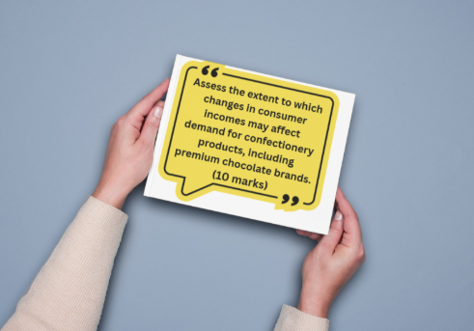
Factors leading to a change in demand: Consumer incomes in the confectionery industry
As incomes rise, demand for normal and income-elastic goods increases, while demand for inferior goods may fall
Premium confectionery benefits from income growth due to higher spending of disposable income
Try the sample question
Notes:
Answers in the PDF in the pack in SECTION A TRENDS

Slide 41

Factors leading to a change in demand: Fashions, tastes and preferences in the confectionery industry
Changes in consumer preferences can significantly affect demand, especially in markets driven by lifestyle trends, such as confectionery
Health consciousness, ethical consumption, and flavour innovation can rapidly change demand
Try the sample question
Notes:
Answers in the PDF in the pack in SECTION A TRENDS

Slide 42
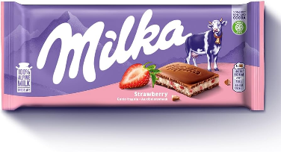
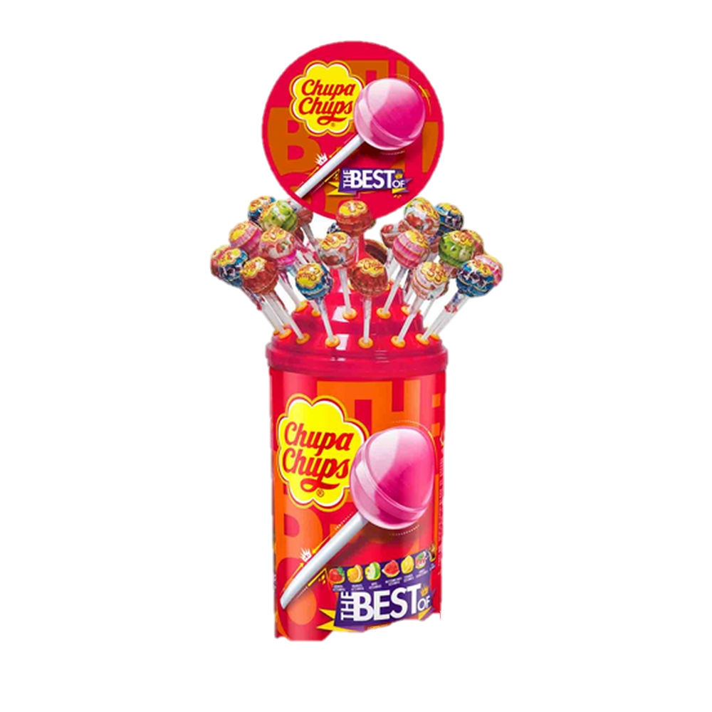

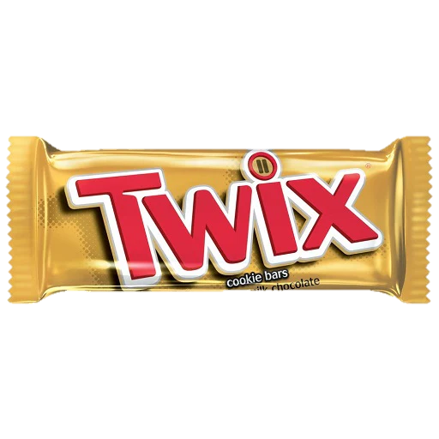
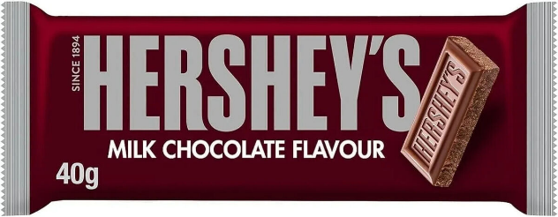
Activity – rank the brands
These are the top 10 global confectionery brands by revenue ($) rank them in order 1-10. 1 being the highest revenue and 10 being the lowest
Answers on next slide
Chupa Chups
Milka
Haribo
Toblerone
KitKat
Hershey bars
Kinder
Lindor
Dairy Milk
Twix
Notes:
Author’s note:
This introduces students to the large global brands and starts a discussion of why they are the largest, and what part did advertising play in the growth of these brands. This is a nice low risk activity to bring students round to thinking about branding and the context. Revenue is always in $USA when comparing global brands.

Slide 43
Brands (ranked in order of $value)
Mars –Twix
Cadbury (Mondelēz International) – Dairy Milk
Ferrero Rocher (Ferrero Group) –Kinder
Hershey’s (The Hershey Company) – Hershey’s bars
Lindt & Sprüngli – Lindor
KitKat (Nestlé)
Toblerone (Mondelēz International)
Milka (Mondelēz International)
Haribo
Chupa Chups (Perfetti Van Melle)

Slide 44

Factors leading to a change in demand: Advertising and branding in the confectionery industry
Effective advertising and strong branding increase added value, brand loyalty, and customer awareness
Increased advertising and branding campaigns will lead to an increase in demand, shifting the demand curve to the right
Try the sample question

Slide 45

Factors leading to a change in demand: Demographics in the confectionery industry
Changes in population size, age structure, and cultural composition influence market demand
Younger demographics (Gen Z) may increase demand for impulse confectionery, while older demographics may have more established brand loyalty (Gen X)
Try the sample question

Slide 46

Factors leading to a change in demand: External shocks in the confectionery industry
Unexpected external events can cause sudden shifts in demand due to changes in consumer behaviour, income uncertainty, or supply disruption
For example consider how COVID changed how customers bought sweets and chocolate, switching to online shopping sources
Try the sample question

Slide 47

Factors leading to a change in demand: Seasonality in the confectionery industry
Demand for confectionery fluctuates throughout the year due to seasonal events and cultural traditions e.g. Valentines day, Halloween, Christmas and Easter
Confectionery companies experience predictable peaks and troughs, requiring effective capacity planning and stock control
Try the sample question

Slide 48
1.3.1 Product / service design

Slide 49
1.3.1 Product / service design
a) Design mix:
  function
  aesthetics
  cost
b) Changes in the elements of the design mix to reflect social trends:
  concern over resource depletion: designing for waste minimisation, re-use and recycling
  ethical sourcing

Slide 50
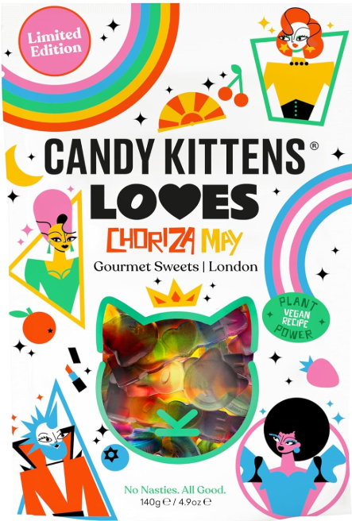

Design mix in the confectionery industry
Design mix refers to balancing function, aesthetics, and cost when developing a product
Function focuses on how well the product performs its intended purpose
Aesthetics relate to appearance and visual appeal
Cost considers production expenses and pricing, ensuring the product is profitable while remaining competitive

Slide 51
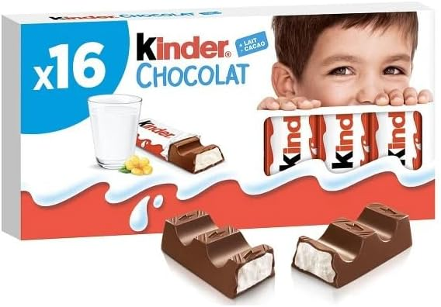
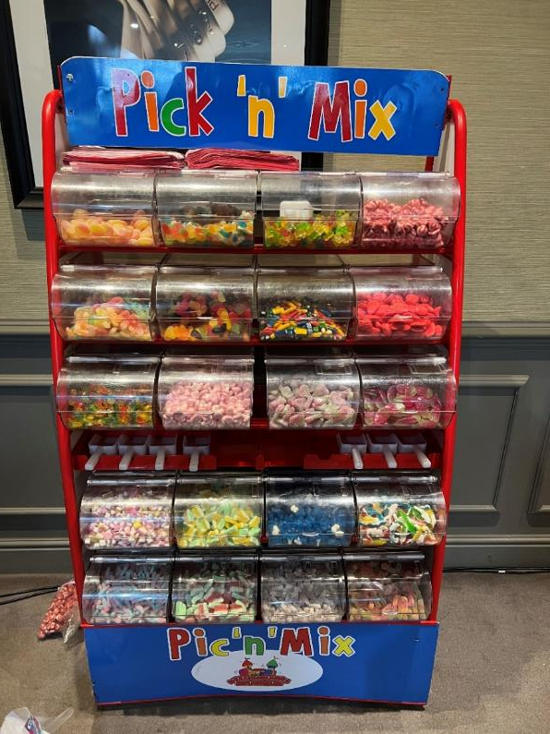
Confectionery designed with function in mind
Explain why these are good examples

Slide 52
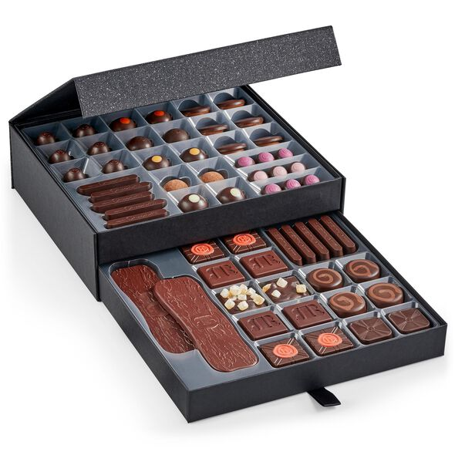
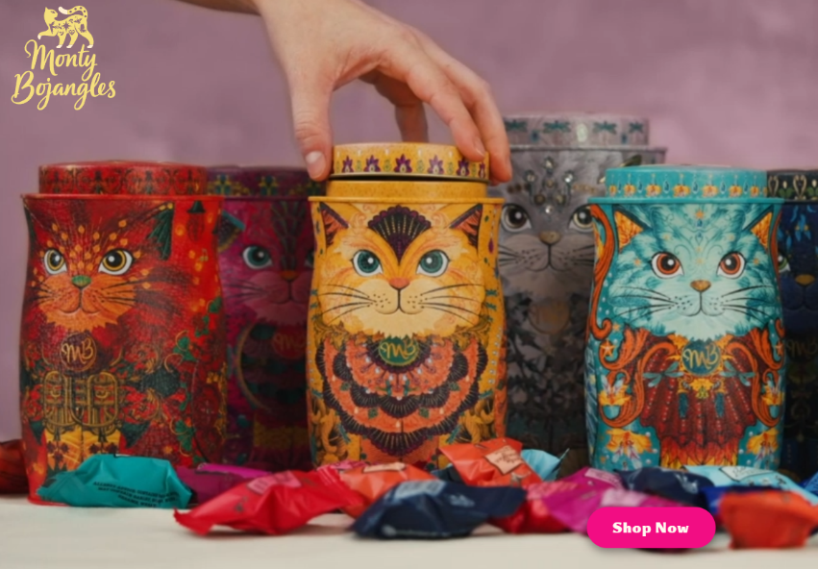
Confectionery designed with aesthetics in mind
Explain why these are good examples

Slide 53
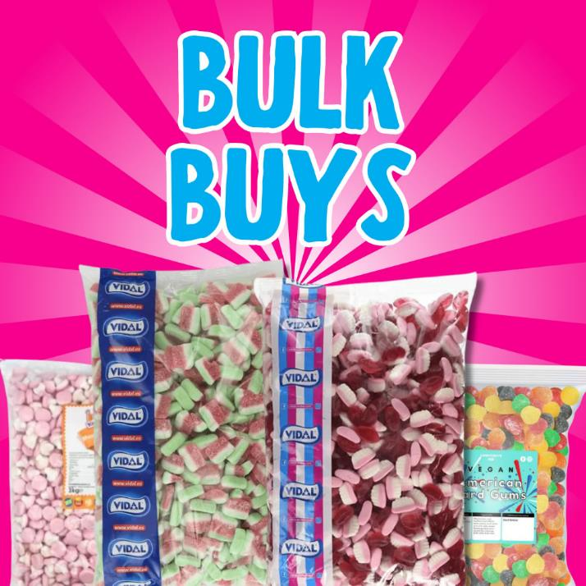
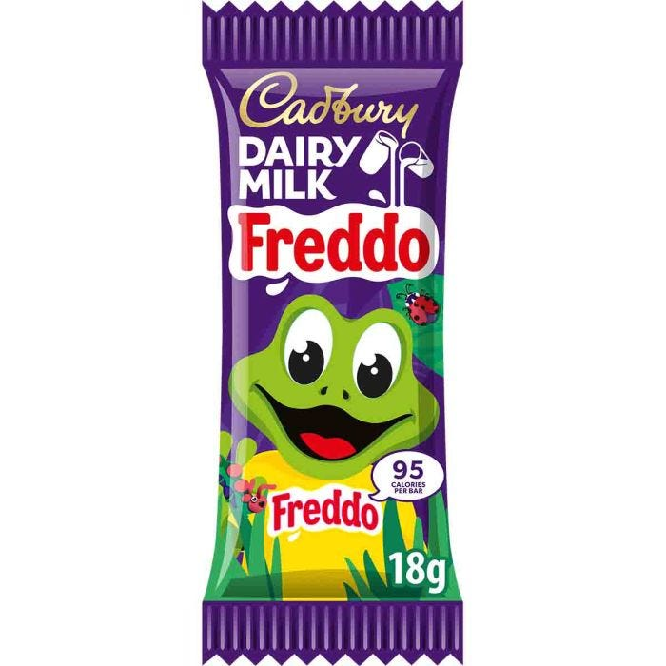
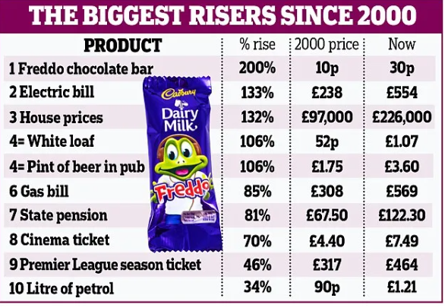
Confectionery designed with cost in mind
Explain why these are good examples

Slide 54
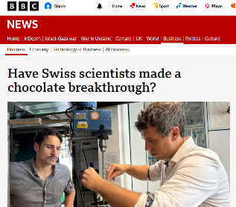
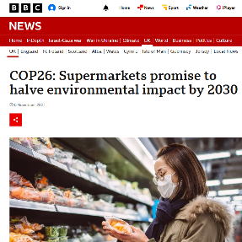
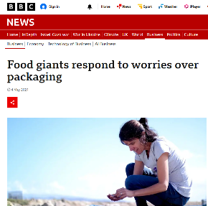
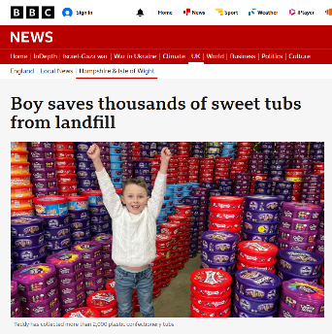
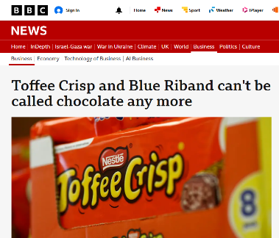
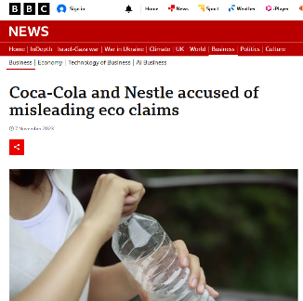
Changes in the elements of the design mix to reflect social trends
Concern over resource depletion | Designing for waste minimisation
Re-use and recycling | Ethical sourcing
Notes:
Author’s note:
Challenge students to make their own table of links to articles – make these tables of links common practice in the research phase. Students could make these in Word or PPT or Canva and then provide summaries of what they have read.

Slide 55
1.3.2 Branding and promotion

Slide 56
1.3.2 Branding and promotion
a) Types of promotion
b) Types of branding
c) The benefits of strong branding:
  added value
  ability to charge premium prices
  reduced price elasticity of demand
d) Ways to build a brand
  unique selling points (USPs)/differentiation
  advertising
  sponsorship
  the use of social media
e) Changes in branding and promotion to reflect social trends:
  viral marketing
  social media
  emotional branding

Slide 57

Types of promotion in the confectionery industry
In the confectionery industry, promotion includes advertising chocolates and sweets on TV and social media.
Sales promotions like buy-one-get-one-free, discounts and samples, attractive point-of-sale displays, sponsorship of events, public relations
Digital marketing such as online ads, influencers, competitions and interactive campaigns to boost brand awareness and sales growth globally

Slide 58
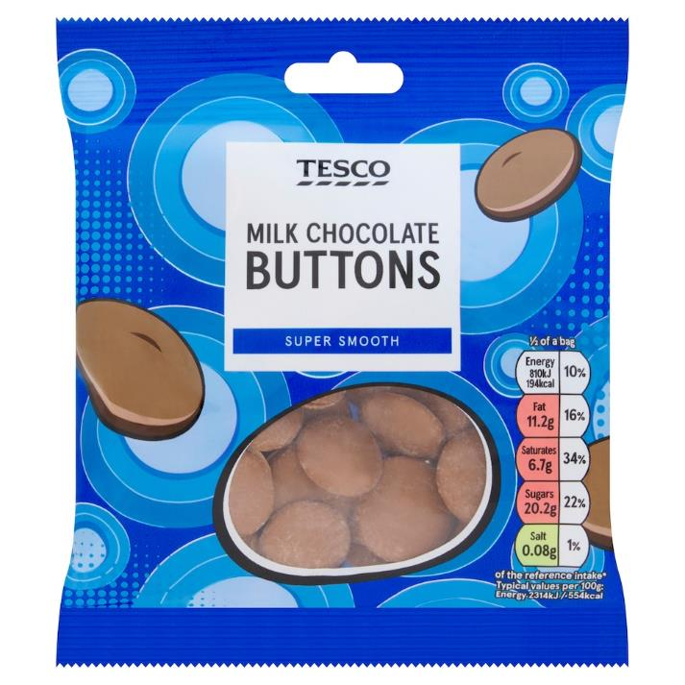
Types of branding in the confectionery industry
In the confectionery industry, branding includes corporate brands like Nestlé, product brands such as KitKat, and supermarket own-label chocolates.
Each has advantages and disadvantages for consumers and producers. Rebranding involves changing names, logos or designs to refresh an established sweet brand and create a new, differentiated market image.

Slide 59
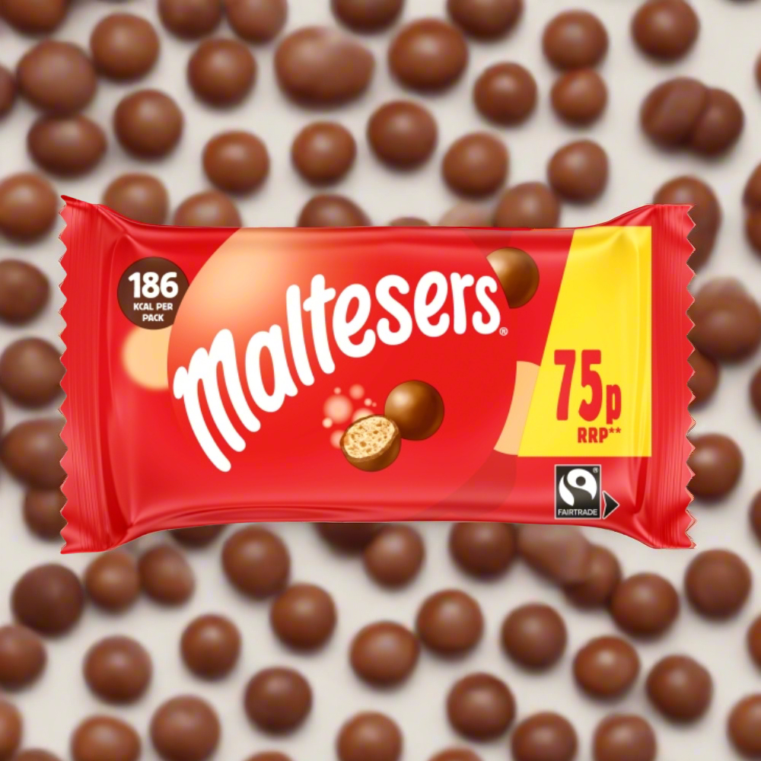
The benefits of strong branding
In the confectionery industry, strong branding adds value, allowing firms to charge higher prices and reduce price elasticity of demand, making demand more inelastic.
For example, well-known chocolate brands gain loyal customers
Name some Brandnomers in the confectionery industry
Notes:
Suggested answers – brandnomers (students may disagree with these!)
Smarties – sometimes used to describe any chocolate button
Mars bar – sometimes used generically to mean a chocolate bar
Haribo – used to refer to gummy sweets in general, especially in those small packets
Maltesers – used to describe any malted chocolate balls

Slide 60
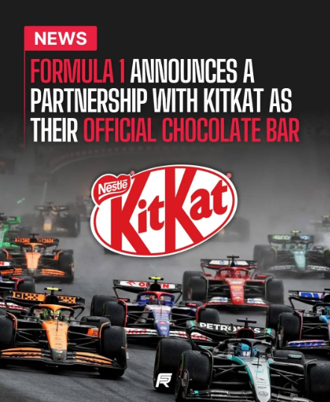
Ways to build a brand
In the confectionery industry, brands are strengthened through clear USPs and product differentiation, such as premium chocolate using high-quality cocoa or unique flavours e.g. sour
Brands are built using TV advertising, sponsorship of events, and social media marketing, including influencer endorsements, online competitions and interactive content to increase awareness and loyalty

Slide 61
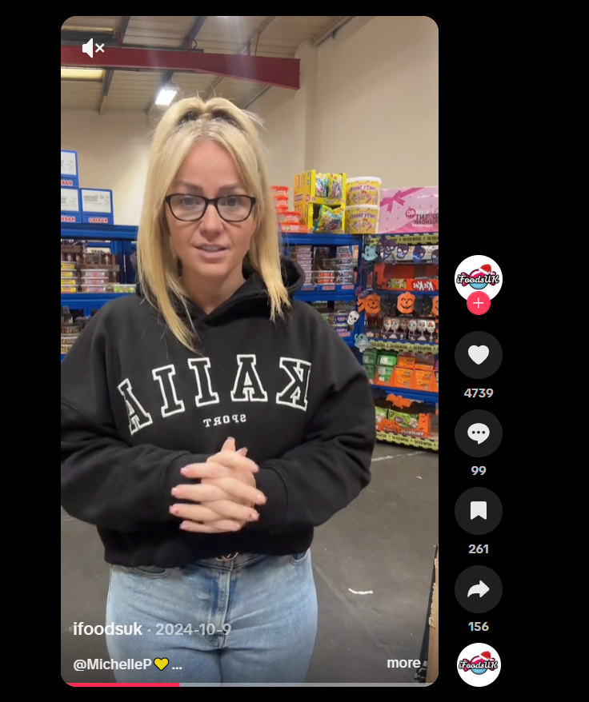
Changes in branding and promotion to reflect social trends
In the confectionery industry, viral marketing uses shareable videos, games, images and online competitions to spread quickly through social media platforms like Instagram and TikTok
Emotional branding is also important, with sweet brands appealing to feelings of happiness, nostalgia and indulgence to influence consumer preferences and encourage repeat purchases
Do you have a brand of confectionery that you have an emotional connection with?

Slide 62
1.3.3 Pricing strategies

Slide 63
1.3.3 Pricing strategies
a) Types of pricing strategy:
  cost plus (calculating mark-up on unit cost)
  price skimming
  penetration
  predatory
  competitive
  psychological
b) Factors that determine the most appropriate pricing strategy for a particular situation:
  number of USPs/amount of differentiation
  price elasticity of demand
  level of competition in the business environment
  strength of brand
  stage in the product life cycle
  costs and the need to make a profit
c) Changes in pricing to reflect social trends:
  online sales
  price comparison sites

Slide 64
Activity: Types of pricing strategy
Cost-plus | Price skimming | Penetration
Predatory | Competitive | Psychological
Match these strategies with the examples given on the next slide
Notes:
Author’s note: This can be run as a whole class on the board quiz or you can print out the PDF activity to give as a homework or a starter or even a brain break on topic. That’s why we called the activities pick and mix so you have a wide bank of things to do, depending on the mood of the group, what is happening that day etc.

Slide 65






Match the example to the pricing strategy

Slide 66


Types of pricing strategy - answers
Cost-plus | Price skimming | Penetration
Predatory | Competitive | Psychological

Slide 67

Factors that determine the most appropriate pricing strategy for a particular situation

Slide 68



Changes in pricing to reflect social trends – online sales
Confectionery companies change prices to match social trends
More customers buy sweets online, so firms offer discounts, bundles, and delivery deals.
Online pricing is flexible, with flash sales, loyalty rewards, and personalised offers to attract digital customers

Slide 69



Changes in pricing to reflect social trends – price comparison sites
What are the advantages to confectionery businesses of price comparison sites?
Notes:
Suggested answers (in brief):
It increased online visibility and bran awareness
Able to reach the price sensitive customers
Clear old stock ready for a new season
Boost sales volume
Increase market share

Slide 70
2.2.1 Sales Forecasting

Slide 71
2.2.1 Sales Forecasting
a) Purpose of sales forecasts
b) Factors affecting sales forecasts:
  consumer trends
  economic variables
  actions of competitors
c) Difficulties of sales forecasting

Slide 72

Purpose of sales forecasts
Instructions: Identify which of these are REAL uses of sales forecasts and which are fake (confectionery industry edition)
Answers on the next slide

Slide 73

Purpose of sales forecasts
Answers
Real = green
Fake = red

Slide 74


Factors affecting sales forecasts
Scenario
Haribo launches Tangy Bears, a sour gummy targeting teenagers, supported by social media advertising and supermarket promotions, amid rising sugar awareness and strong competition, with a full UK launch planned; which factors could increase or decrease sales?
Notes:
Author’s note: answers on next slides

Slide 75

Factors affecting sales forecasts
Notes:
Author’s note:
These are just suggestions, students could have used PESTLE factors too such as increased inflation rates, or cost of living crisis (sweets seen as a luxury not a necessity).

Slide 76

Factors affecting sales forecasts

Slide 77
Difficulties in sales forecasting: fill the gaps
Although the risk of producing _______________ forecasts can be reduced, forecasts are not ________________ and businesses operating in _______________ markets will find it __________________________________ more difficult to forecast accurately beyond a very _____________ period of time in the _______________.
Dynamic
Significantly
Short
Future
Inaccurate
Guaranteed
Notes:
Author’s note:
This is taken from the Edexcel Getting started guide

Slide 78
Difficulties in sales forecasting
Although the risk of producing inaccurate forecasts can be reduced, forecasts are not guaranteed and businesses operating in dynamic markets will find it significantly more difficult to forecast accurately beyond a very short period of time in the future.

Slide 79
4.2.1 Conditions that prompt trade

Slide 80
4.2.1 Conditions that prompt trade
a) Push factors:
  saturated markets
  competition
b) Pull factors:
  economies of scale
  risk spreading
c) Possibility of off-shoring and outsourcing
d) Extending the product life cycle by selling in multiple markets

Slide 81

Push and pull factors
Instructions
Identify two push factors in the confectionery industry and two pull factors that might have an impact on consumer trends
Add them to this diagram and colour code the sections
Notes:
This activity is not in the sample
Some suggestions (although students could use AI to help them with this):
PUSH
New products – companies create healthier sweets
Advertising and offers – personalisation of sweets and chocolate
PULL
Health concerns – consumers want low sugar options
Convenience – consumers preferring to shop online for sweets
This could make a nice class display, be useful as a home work, or could be set as a cover activity.

Slide 82



Possibility of off-shoring and outsourcing
Offshoring
Companies move production to countries with lower labour costs to reduce costs and stay competitive in the global confectionery industry
Outsourcing
Confectionery firms outsource packaging, logistics, and marketing to specialist companies, reducing costs, improving efficiency, and allowing focus on core production
Notes:
Hopefully these images will help students not to get the two mixed up.

Slide 83

Extending the product life cycle by selling in multiple markets
Confectionery brands can extend a product’s life by selling in new markets
Different countries have new tastes, seasons, and buyers
This spreads risk, increases sales time, and reduces waste. Small changes in flavour, size, or packaging help products stay popular for longer and support steady growth for global confectionery businesses

Slide 84


Sample Exam Questions

Slide 85

Case study for sample question 1

Slide 86


Sample question 1

Slide 87


Answer sample question 1

Slide 88

How to level an 8 mark answer
(Only on paper 3)
No conclusion required on the 8 mark questions on paper 3

Slide 89


Sample question 2

Slide 90


Answer sample question 1

Slide 91

How to level a 10 mark answer

Slide 92


