Slide 1
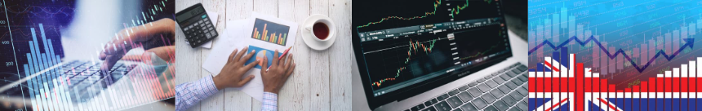


Edexcel Economics A
Theme 1: Introduction to markets and market failure
1.2.10 Alternative views of consumer behaviour

Slide 2
Retrieval quiz from previous topic
4 Quick questions to get you started, short answers required:
Name the three functions of the price mechanism (Unit 1.2.7)
Explain the difference between a consumer and a producer surplus (Unit 1.2.8)
What is an indirect tax? (Unit 1.2.9)
What is a subsidy? (Unit 1.2.9)

Slide 3
Retrieval quiz answers
Functions of the price mechanism to allocate resources:
    rationing
    incentive
    Signalling
A consumer surplus is when buyers pay less than they were willing to, and a producer surplus is when sellers get more than their minimum acceptable price
An indirect tax is a tax that’s collected by a business or retailer on behalf of the government, rather than being paid directly by individuals
A subsidy is money given by the government to a producer to help reduce the cost of producing or buying certain goods and services

Slide 4
Learning objectives
a) The reasons why consumers may not behave rationally:
  consideration of the influence of other people's behaviour
  the importance of habitual behaviour
  consumer weakness at computation

Slide 5

Starter
When you want to buy something, which of these influences you? You can choose multiple answers, justify your answer.
Friends / mates
Family / relatives
Your phone / social media
Other e.g. sponsorship
Bought it before, why change?
Buy the same thing every week

Slide 6

Definition: Utility maximisation
Utility maximisation is when consumers make choices to get the highest possible satisfaction or benefit (value for money) from their limited resources, such as money or time.

Slide 7
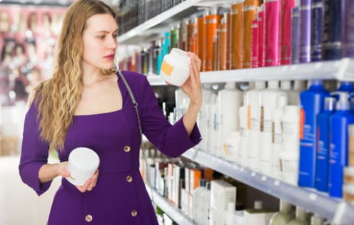
Rational consumer behaviour
Rational consumer behaviour means people carefully choose products to maximise their utility
Consumers compare benefits and costs, selecting options providing greatest value
They consider prices, quality, and personal preferences
This is RATIONAL behaviour, but consumers do not always do this…

Slide 8

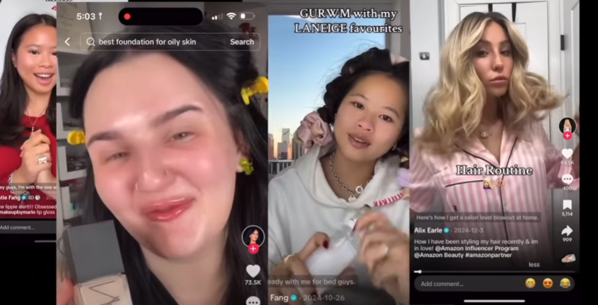
Irrational consumer behaviour
Irrational consumer behaviour occurs when people make decisions against their own interests or logic
Consumers may be:
  Impulse-buying
  Following influencers
  Misjudging value
  Emotional purchases
  Habitual purchases
  Poor calculations leading to mistakes
  Buying due to inertia
What is inertia in this context?
Notes:
Answer:
Inertia is the ‘stickiness’ of what consumers buy. It takes effort to learn something new, to change and most shoppers will keep to the same routines and buy the same products. Even if a cheaper or better alternative exists. For example could we get you to change your brand of toothpaste?

Slide 9
Consideration of the influence of other people's behaviour

Slide 10
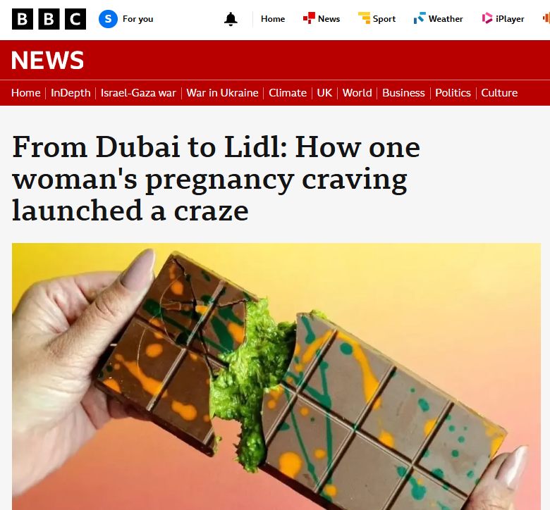
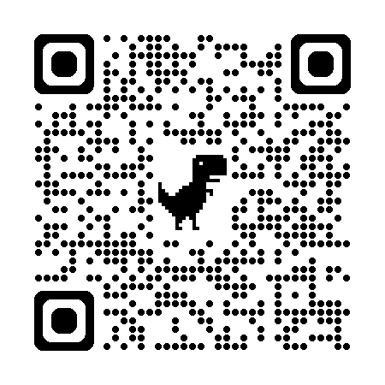
Influences on consumer behaviour
From an economics viewpoint, other people's behaviour influences decisions
Individuals often mimic others, known as herd behaviour
Choices depend on social trends, leading to shifts in demand e.g. viral trends
Understanding this helps predict market changes, as consumer actions frequently reflect collective influences rather than purely individual preferences, shaping overall economic outcomes
Can you name any other viral trends?
Notes:
Suggested answers:
Labubu dolls
Prime drinks
Fidget spinners

Slide 11
The importance of habitual behaviour

Slide 12

Habitual behaviour
Be honest….
Do you have a subscription that you have forgotten about?
Or have you set up a direct debit and can’t remember what its for?
Have you started a free trial and forgotten to cancel it?
Habitual behaviour matters because consumers repeat familiar choices without thinking
This affects spending patterns, creates stable demand, and allows businesses to predict sales

Slide 13
Consumer weakness at computation

Slide 14
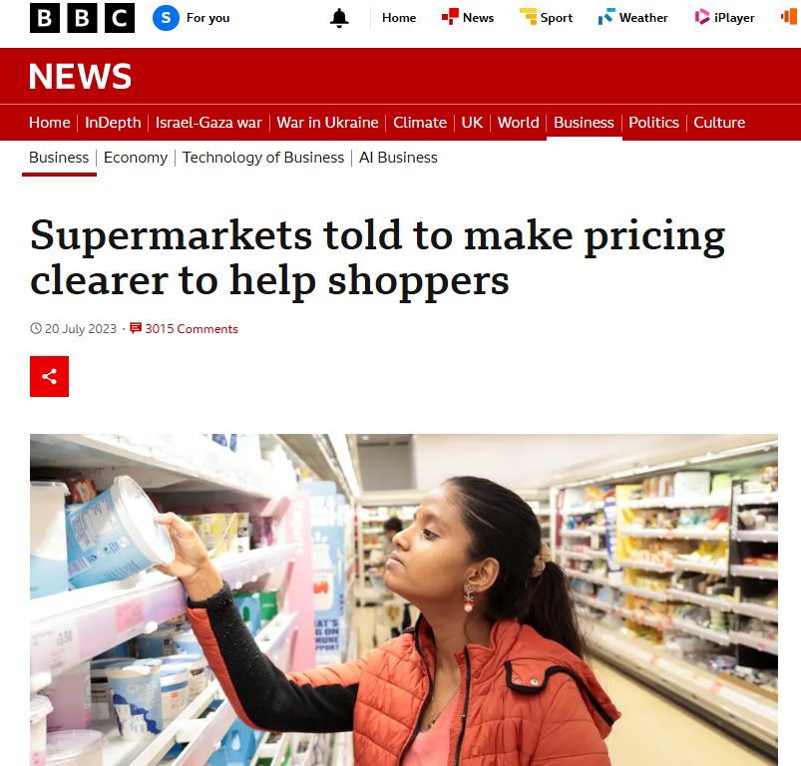
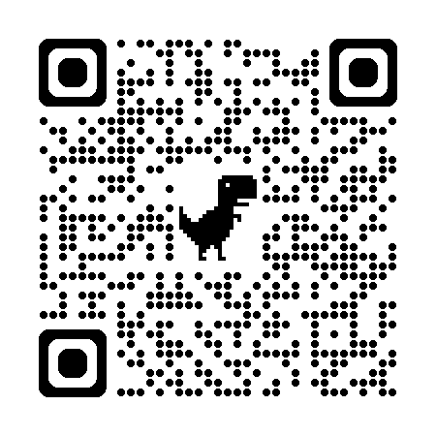
Consumer weakness at computation (numbers, addition etc.)
Consumers often struggle with computation
This means they find it difficult to calculate exact value or compare prices accurately
Businesses exploit this by simplifying offers or using misleading discounts
Recognising this weakness helps economists understand decision-making errors, leading to better consumer protection

Slide 15
Plenary quiz questions
Are these statements RATIONAL or IRRATIONAL consumer behaviour?
Consumer weighs up the difference between the price of similar products before selecting a purchase
Consumer allows their car insurance to auto renew even though the price has gone up this year
Consumer buys clothes that they saw on TikTok and when they arrive they are the wrong colour, an inferior fabric and don’t fit
Consumer uses a list when shopping and sticks to brands they have always bought

Slide 16
Plenary quiz answers
Rational – weighing up is a logical and rational action
Irrational – allowing the auto renew is more expensive they should have shopped around to get maximum utility
Irrational – swayed by viral trends on social media without seeing the clothes first or trying them on
Irrational – inertia not shopping around

Slide 17


Slide 18
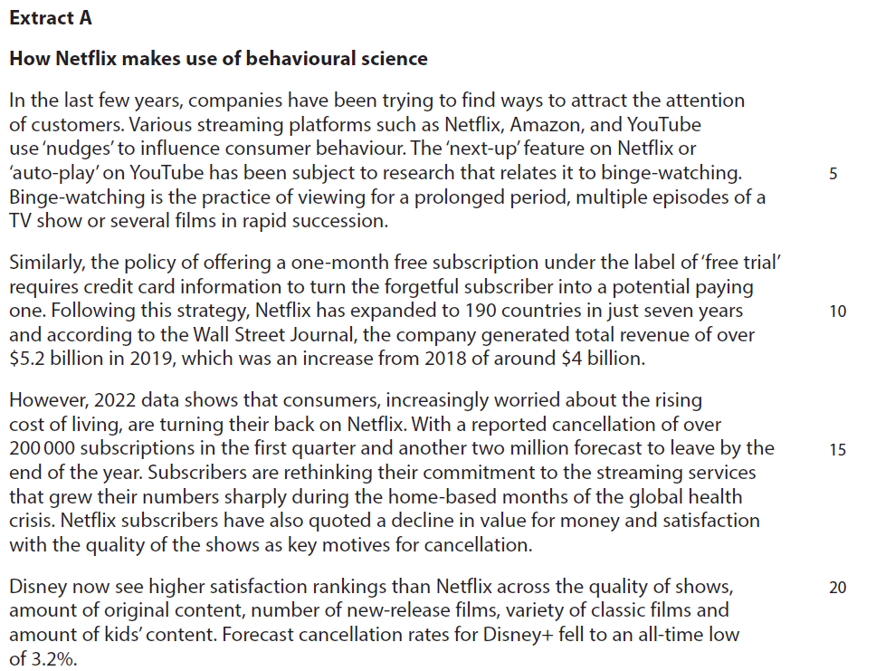
Case study for sample question 1

Slide 19
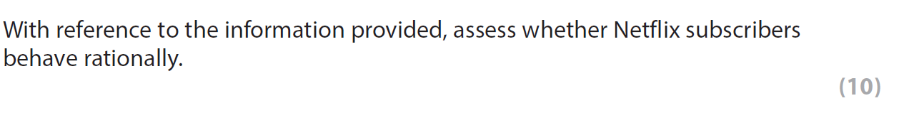
Sample question 1
Knowledge
2
Analysis
2
Application
2
Evaluation
4

Slide 20
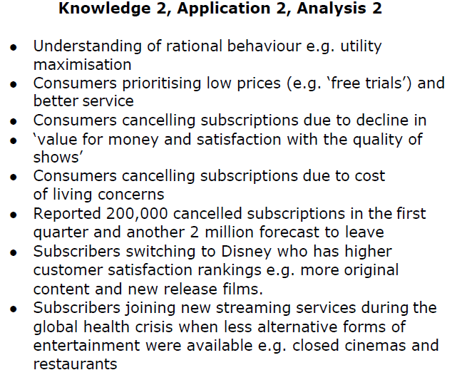
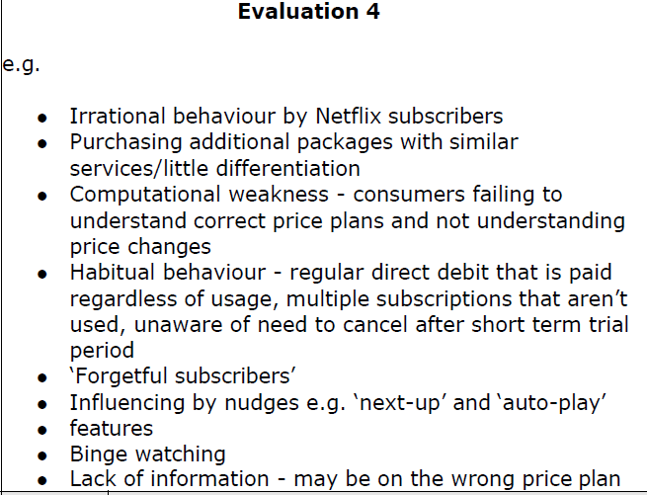
Answers
Notes:
Notes to the question given in the mark scheme:
NB: For Level 3 candidates must refer to Netflix subscribers
NB: Netflix subscribers acting irrationally may be seen as KAA (Knowledge, Application, Analysis) and then rational behaviour as EV (Evaluation)

