Slide 1




Slide 2
Note
The answers are on slide 12 of this Quiz presentation.
On a piece of scrap paper write the numbers 1-10

Slide 3
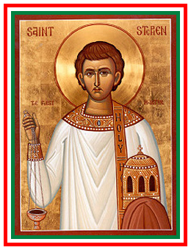
Question 1
What date is St Stephen's Day?

Slide 4
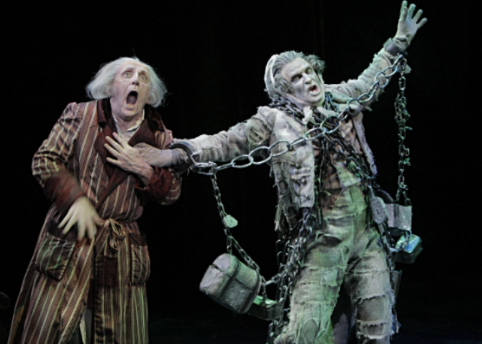
Question 2
In Charles Dickens' novel A Christmas Carol, who was Scrooge's dead business partner?

Slide 5




Question 3
In the song The Twelve Days of Christmas, '...my true love brought to me nine...' what?

Slide 6
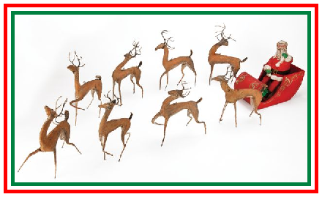
Question 4
Name all the original eight reindeers from the 'Twas the night Before Christmas' poem

Slide 7

Question 5
What colour are the berries of the mistletoe plant?

Slide 8

Question 6
What is New Year's Eve called in Scotland?

Slide 9

Question 7
Who wrote: How the Grinch Stole Christmas?

Slide 10
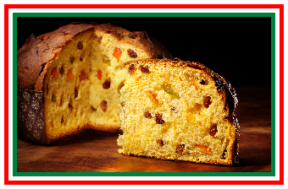
Question 8
What is the name of the cake traditionally eaten in Italy at Christmas?

Slide 11
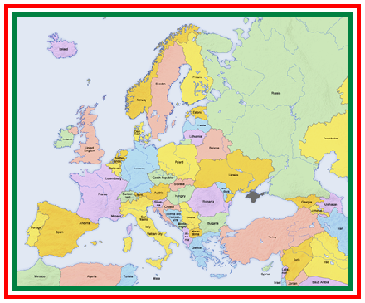
Question 9
'Nadolig Llawen' means Merry Christmas in which European language?

Slide 12

Question 10
Advent candles are a popular Christmas tradition in many cultures. What does the word advent mean?

Slide 13
Answers
1 Boxing Day or 26th Dec
2 Marley
3 Ladies dancing
4 "Now Dasher! now, Dancer! now, Prancer and Vixen!
On, Comet! On, Cupid! on, on Donner and Blitzen!
To the top of the porch! to the top of the wall!
Now dash away! Dash away! Dash away all! (no Rudolf)
You only get the mark if you got all 8!
5 White
6 Hogmanay
7 Dr Seuss
8 Panettone or Panetone
9 Welsh
10 Arrival

