Slide 1
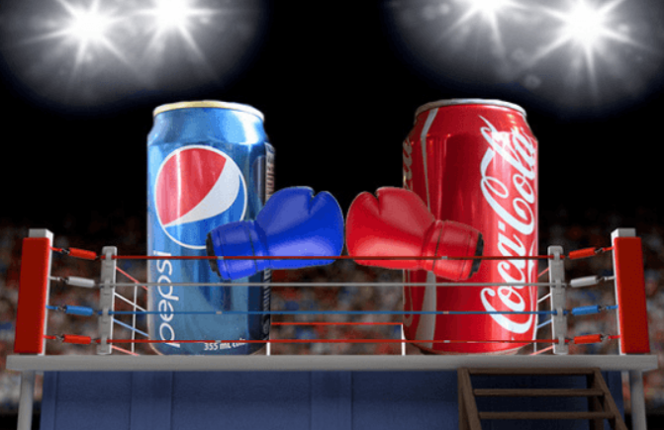
Market research
Year 9 business Pepsi Challenge

Slide 2
The Pepsi challenge is a famous marketing strategy

Slide 3
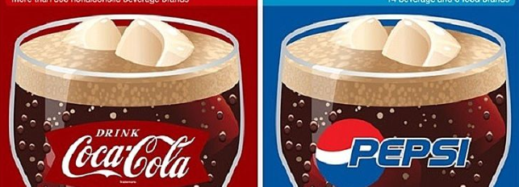
The market research question – TASK 1
Can consumers taste the difference between:
Coke
Pepsi
Supermarket own brand Cola
In pairs decide what 3 questions should be asked, design a simple questionnaire to gather quantitative and qualitative data
Explain how you will carry out your research and gather your data

Slide 4
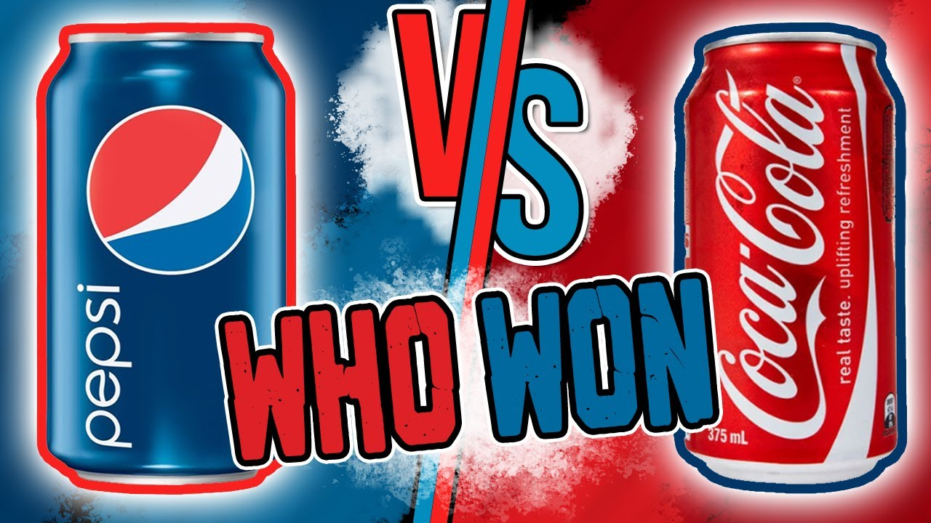
Blind taste test – TASK 2
This is a blind taste test
Can you predict the outcome?
Before you taste make a note of your preference e.g. you only like Pepsi

Slide 5
What if? – TASK 3
How would this change the results?
One was flat and the others were fizzy?
One was warm and the others cold?
Students don’t like any sort of cola?
Coke was from a can but the other two were from a bottle?
Coke was diet and Pepsi wasn’t

Slide 6
Results, analysis and conclusions – TASK 4
Gather your data
Analyse your results
Draw some conclusions about the research

