Slide 1
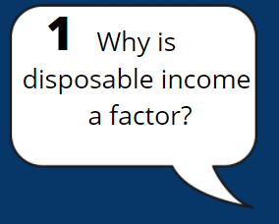
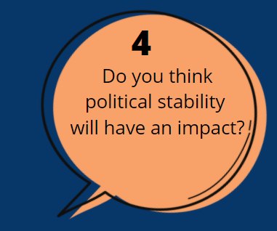
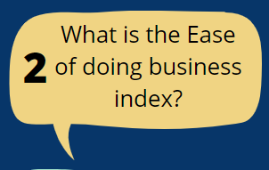
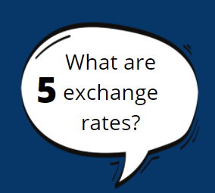
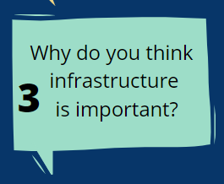

Slide 2
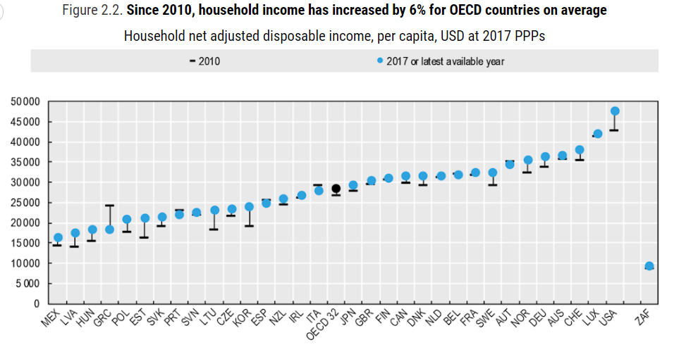
1 Why is disposable income a factor?
Household disposable income is the amount of money that a household earns, or gains, each year after taxes
It represents the money available to a household for spending on goods or services
If a country’s citizens have low disposable income what does this mean for business?

Slide 3
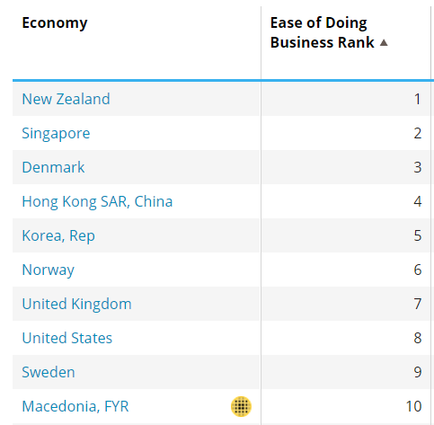
2 What is the ease of doing business index?
The ease of doing business index is an index created by the World Bank Group
Higher rankings (a low number) indicate better, usually simpler paperwork for businesses and stronger protection of intellectual property rights e.g. patents
Can you guess which country has the worst Ease of Doing Business Ranking in the world?

Slide 4
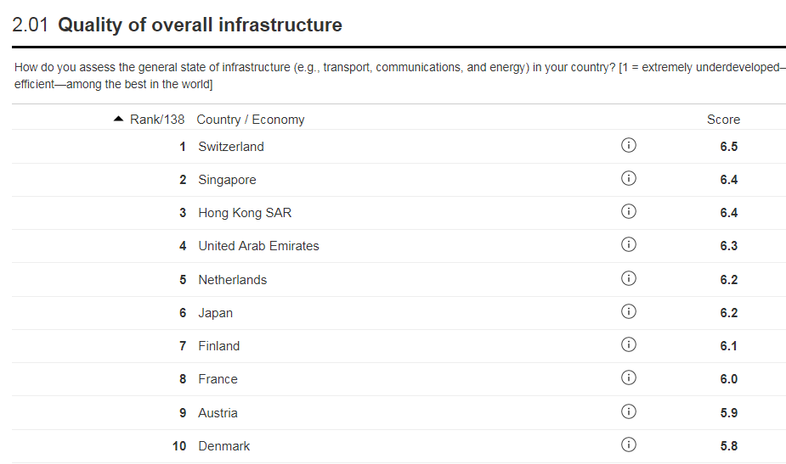
3 Why is infrastructure important?
Infrastructure can mean roads, ports, airports, rail and road transport. Without this a business cannot deliver to its customers on time
Infrastructure can also mean telecommunications and wifi, without this a business cannot communicate with its suppliers and its customers
Why else might wifi be critical?
ICT development index

Slide 5
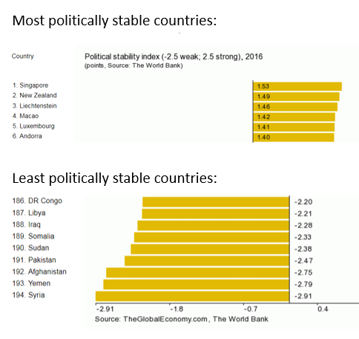
4 What is the impact of political stability?
Political instability in a country could be a major risk factor
Each new government may seek to impose a series of laws which will need to be adhered to e.g. environment laws, employment laws which could have an impact on the business costs
Would a country at war make a good market?

Slide 6
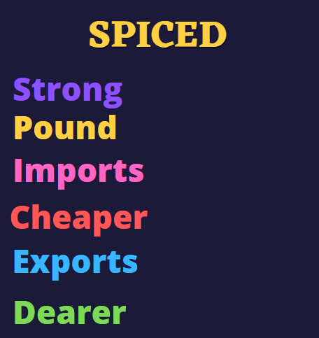
5 What are exchange rates?
Exchange rates are the value of one currency in exchange for another
When trading internationally a UK business will need to look at the exchange rates with the other countries
This can have an impact on trade depending if imports or exports
What is the opposite to SPICED?

Slide 7
Instructions
Show the PowerPoint and click on each question as students pick a number, this will take it to that slide.
Click on the Home graphic on each slide to take it back to the title slide to pick numbers again.

