Slide 1
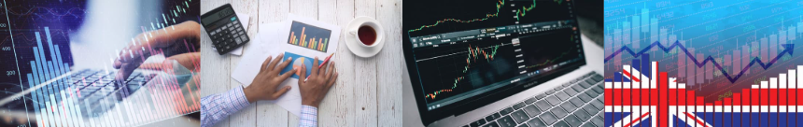


Edexcel Economics A
Theme 1: Introduction to markets and market failure
1.1.1 Economics as a social science

Slide 2
From Edexcel
Thinking like an economist: the process of developing models in economics, including the need to make assumptions
The use of the ceteris paribus assumption in building models
The inability in economics to make scientific experiments

Slide 3
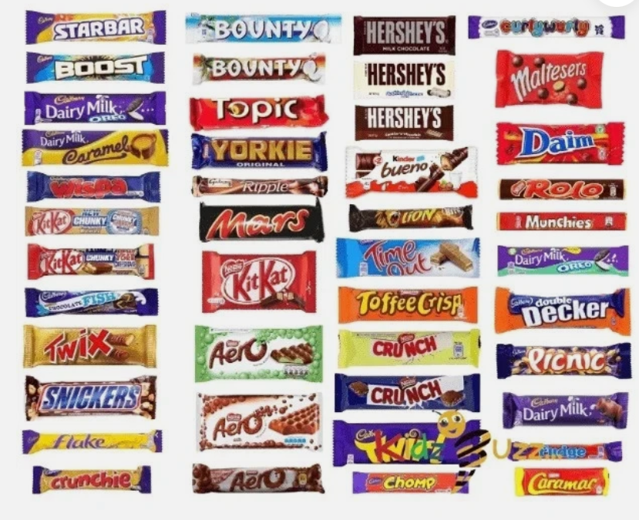
Starter – Think and Discuss:
Imagine the price of a chocolate bar suddenly drops by 50%
What might happen to the number of chocolate bars that consumers buy?

Slide 4
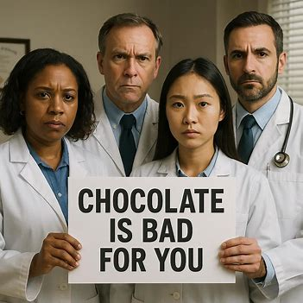
Starter – ideas to consider
What assumptions are you making about everything else in the world when you give your answer about the chocolate?
For example, what if a new scientific study came out at the same time, saying chocolate is now bad for you?

Slide 5

Definition: Economics
Economics is a social science that studies how limited resources are used to produce and consume goods and services. It focuses on the choices made to meet the needs and wants of consumers.

Slide 6
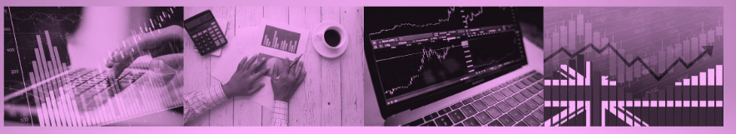
Thinking like an Economist

Slide 7

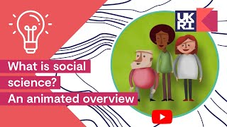

Activity: What does Social Science mean?
What is social science?
Make notes on this video:
Additional questions:
What are some of the key areas that social science research covers?
How does the Economic and Social Research Council (ESRC) ensure the quality of the research they fund?
What are some examples of discoveries made through long-term social science research projects?
Notes:
https://youtu.be/BiLj35g_cAU
Suggested answers (scaffold notes)
“Social science helps us understand society—how people behave, interact, and make decisions. The Economic and Social Research Council (ESRC) funds high-quality research that tackles real-world challenges—from education and crime to the economy and health. Working with academics, policymakers, and the public, ESRC ensures that evidence-based findings improve lives and guide policy.”
1. What are some of the key areas that social science research covers?
Education
Crime and justice
Health and wellbeing
Employment and labour markets
Economic policy
Social inequality
Climate change and sustainability
Political participation and governance
2. How does the Economic and Social Research Council (ESRC) ensure the quality of the research they fund?
Peer review process: Proposals are reviewed by experts in the field.
Rigorous selection criteria: Only projects with strong methodology and impact potential are funded.
Monitoring and evaluation: Ongoing assessment ensures projects meet objectives.
Support for collaboration: Encouraging links between researchers, government, and industry.
3. What are some examples of discoveries made through long-term social science research projects?
Understanding voting behaviour and what drives political engagement.
Early childhood education studies, showing long-term impacts on life outcomes.
Work on ageing and society, influencing healthcare and pensions policy.
Household panel studies, tracking income, family structure, and wellbeing over decades.

Slide 8
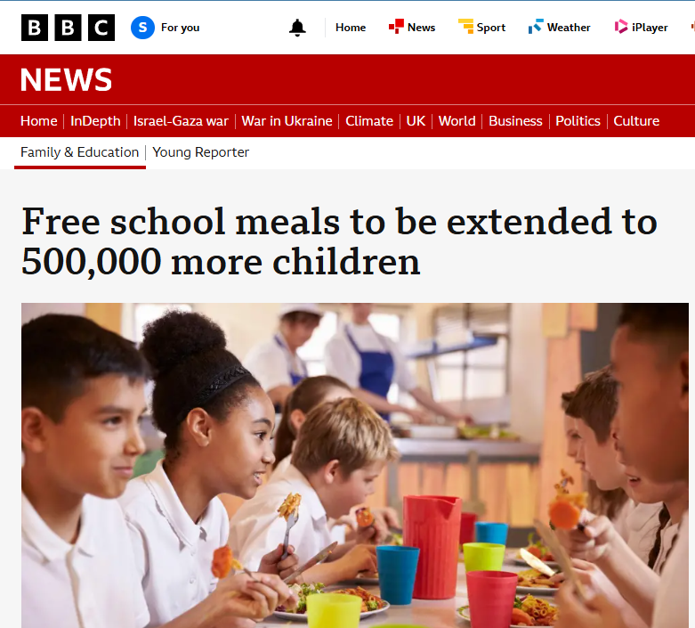

Topic Issue in economics
This discussion looks at economic problems that Government face - Public ‘Costs vs Benefits’
Will giving free school meals to more students improve academic performance?
Notes:
News Story - https://www.bbc.co.uk/news/articles/cdr5mr5l2d1o
Suggested answer:
Free school meals may improve academic performance as all students will be well fed and this could led to increase performance in lessons (concentration). Eventually this may have an impact on the quality of workers and therefore goods and services in the future, so it has a positive externality – more on this in later lessons.

Slide 9

Thinking like an Economist
Thinking like an economist means using models and theories to explain events
Using real life data to make predictions or forecasts on future events
Using statistics and data to test your theories
Remember models reply on simplicity and basic human assumptions

Slide 10
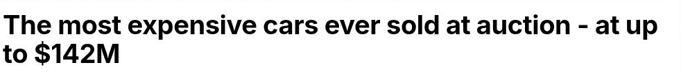
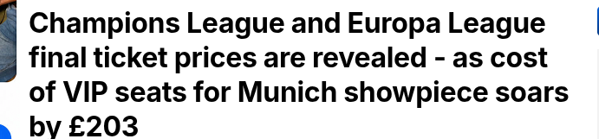
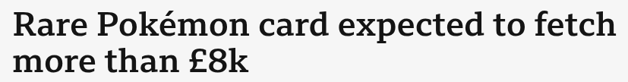
Economic Models
Economists use models to help predict and understand behaviours.
Is it possible to always predict people's behaviour? Do people always act in a rational way?
Do these headlines suggest rational behaviour?
Notes:
Suggested answers:
No - people normally act in their own best interest and this may differ from person to person
These headlines show that some people assign a different value to certain things that others wouldn’t - for example Pokemon cards if you are a collector or this is your hobby you are willing to pay this price.
This can lead to a discussion / debate about the importance of perceived value.

Slide 11
Definition: Opportunity cost
Opportunity cost is the value of the next best alternative foregone

Slide 12
Activity: What would you do? You can only pick one, explain and justify your decision
Decision 1: NHS
Decision 2: Education
In Government you can decide to invest more money in the NHS
What benefits would this bring?
What opportunity costs would there be?
In Government you can decide to invest more money into public education
What benefits would this bring?
What opportunity costs would there be?
Notes:
Author’s note:
We cover opportunity costs in more detail in 1.1.3
Suggested answers:
A NHS - Benefits of investing more in the NHS
Shorter waiting times for consultations, diagnostics and treatment.
Improved quality of care, through better staffing ratios, training and equipment.
Broader service coverage, e.g. expanded mental-health support, community outreach or preventive programmes.
Better health outcomes overall—fewer complications, reduced hospital readmissions and higher life expectancy.
Economic spill-overs from a healthier workforce: higher productivity and lower absenteeism.
B NHS - Opportunity costs of that extra spending
Reduced investment in other public services, such as schools, transport or policing.
Less funding for infrastructure projects (roads, broadband, housing).
Higher taxation or borrowing, which could dampen private-sector activity or increase future debt servicing.
Cuts to welfare or local-government grants, potentially affecting social care, housing support or local amenities.
Delayed investment in research & development or climate-change mitigation programmes.
C - Benefits of investing more in public education
Higher skill levels: Better-trained teachers, smaller class sizes and updated resources boost student learning and competencies.
Greater social mobility: Improved access and support narrows attainment gaps, helping disadvantaged students climb the socioeconomic ladder.
Long-term economic growth: A better-educated workforce raises productivity, spurs innovation and attracts investment.
Reduced social costs: Stronger education correlates with lower crime rates, better health outcomes and reduced welfare dependency.
Civic engagement: Enhanced critical-thinking and civic-education programs foster informed, active citizens.
D - Opportunity costs of that extra spending
Less funding for other services such as healthcare (e.g. the NHS), policing or social care.
Delayed infrastructure projects like roads, public transport or broadband expansion.
Higher taxes or borrowing to pay for the boost, which could dampen consumer spending or burden future budgets.
Cuts to R&D or environmental programmes, potentially slowing scientific advances or climate-action initiatives.
Reduced grants to local authorities or welfare benefits, affecting community services, housing support or elderly care.

Slide 13
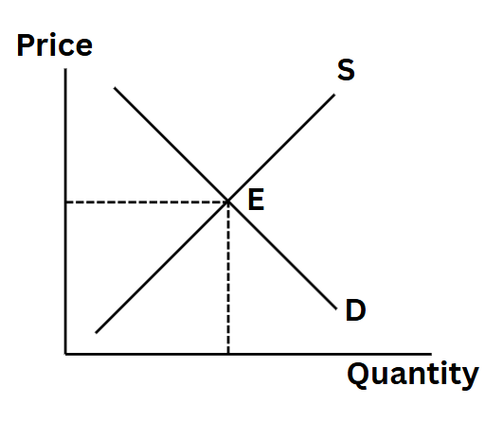
What are economic models?
Economic models are diagrams that represent real world situations
They make assumptions about human behaviour and how firms and markets will respond to situations
These models help economists to predict future events
Two quick questions:
Can you identify 2 benefits for economists of using models?
Can you identify 2 drawbacks for economists of using models?
Answers on next slide

Slide 14
Benefits and drawbacks of using models
Benefits
Drawbacks
Economists can make predictions of future events
Economists can understand why events happen
Helps to predict the markets and potential price changes
Economists can provide future frameworks for Government Policies
They can miss out vital variables
Can be difficult to use when predicting future events (e.g. 2008 recession)
They over-simplify markets, firms and human responses, as real world situations can be more complex

Slide 15
Ceteris Paribus

Slide 16

Challenge: Make your own poster to help you remember this important term.

Slide 17
Definition: Ceteris Paribus
Ceteris paribus is Latin for ‘all else being equal’ meaning we can consider the effect of one change, if we keep everything else constant
Notes:
Author’s note:
This is an important term for students to learn that is all over the exam papers. Might be worth challenging students to make a poster or setting this for homework.

Slide 18

Ceteris Paribus
When economists build models and graphs, they make the assumption of ‘Ceteris Paribus’ this is everything else remains equal
So when comparing 2 factors you can assume that one remains the same whilst the other factor changes
Reflecting on the idea that “lowering the price increases sales,” what other factors could influence customers’ purchasing decisions?
Only the price changes, everything else remains constant
Notes:
Answers:
Health
Government reports
News
Social media and society factors

Slide 19
How does Ceteris Paribus work?
In a Supply and Demand diagram (Units 1.2.2 and 1.2.4) the focus is on only looking at the impact of price changes for that product or service and assumes that all other factors remain the same
What other factors could have an impact of the demand for a Product/ Good or Service?

Slide 20
Importance and issues of using Ceteris Paribus
Importance ➕
Issues ➖
By using the theory of Ceteris Paribus it simplifies complex economic relationships
It supports decision making by make models easier to follow and use
Much easier to see cause and effect between a change in a variable for example price changes
By only focusing on one variable it can be misleading and inaccurate assumptions could be made
When one thing changes (for example price) quite often other variables will also change

Slide 21
The inability in economics to make scientific experiments

Slide 22


Slide 23
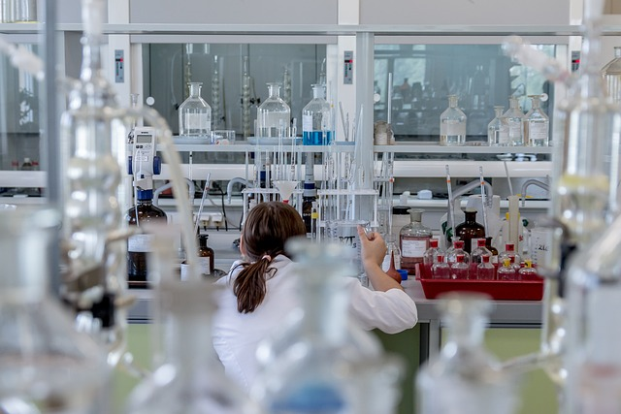
What is Science?
Science is the systematic study of the natural world and its physical and biological processes, through observation, identification, description, experimental investigation, and theoretical explanations*
Therefore science needs factual information and data to make decisions. Do economists also need factual information and data? Answer in slide notes.
Notes:
Quote - https://www.oxfordreference.com/display/10.1093/oi/authority.20110803100447569#:~:text=The%20systematic%20study%20of%20the,experimental%20investigation%2C%20and%20theoretical%20explanations.
Suggested answer:
Yes, economics also needs real-world information and facts to understand how things work and to make good choices. This is because we use actual data to test our ideas and see what policies are truly helpful.

Slide 24
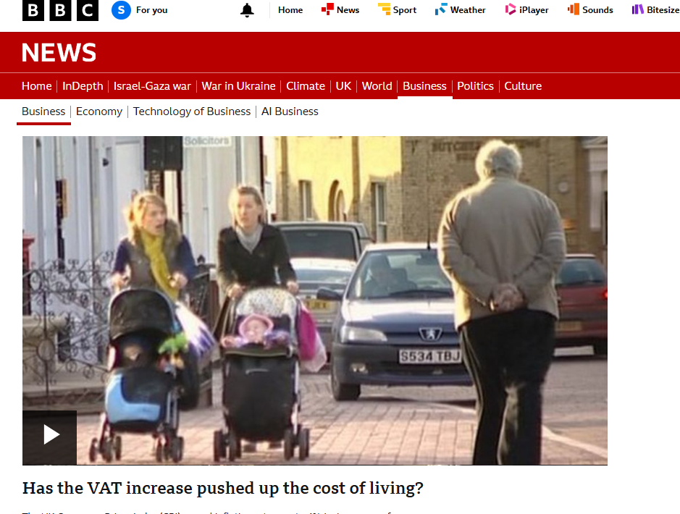

The Inability in economics to make scientific experiments
A scientist can prove the relationships between two variables by conducting experiments.
This is not possible for an economist, for example we cannot conduct an experiment to determine the impact of a 10% increase in VAT
Instead, an economist creates a simplified model of the economy to look at the impact of such an increase

Slide 25
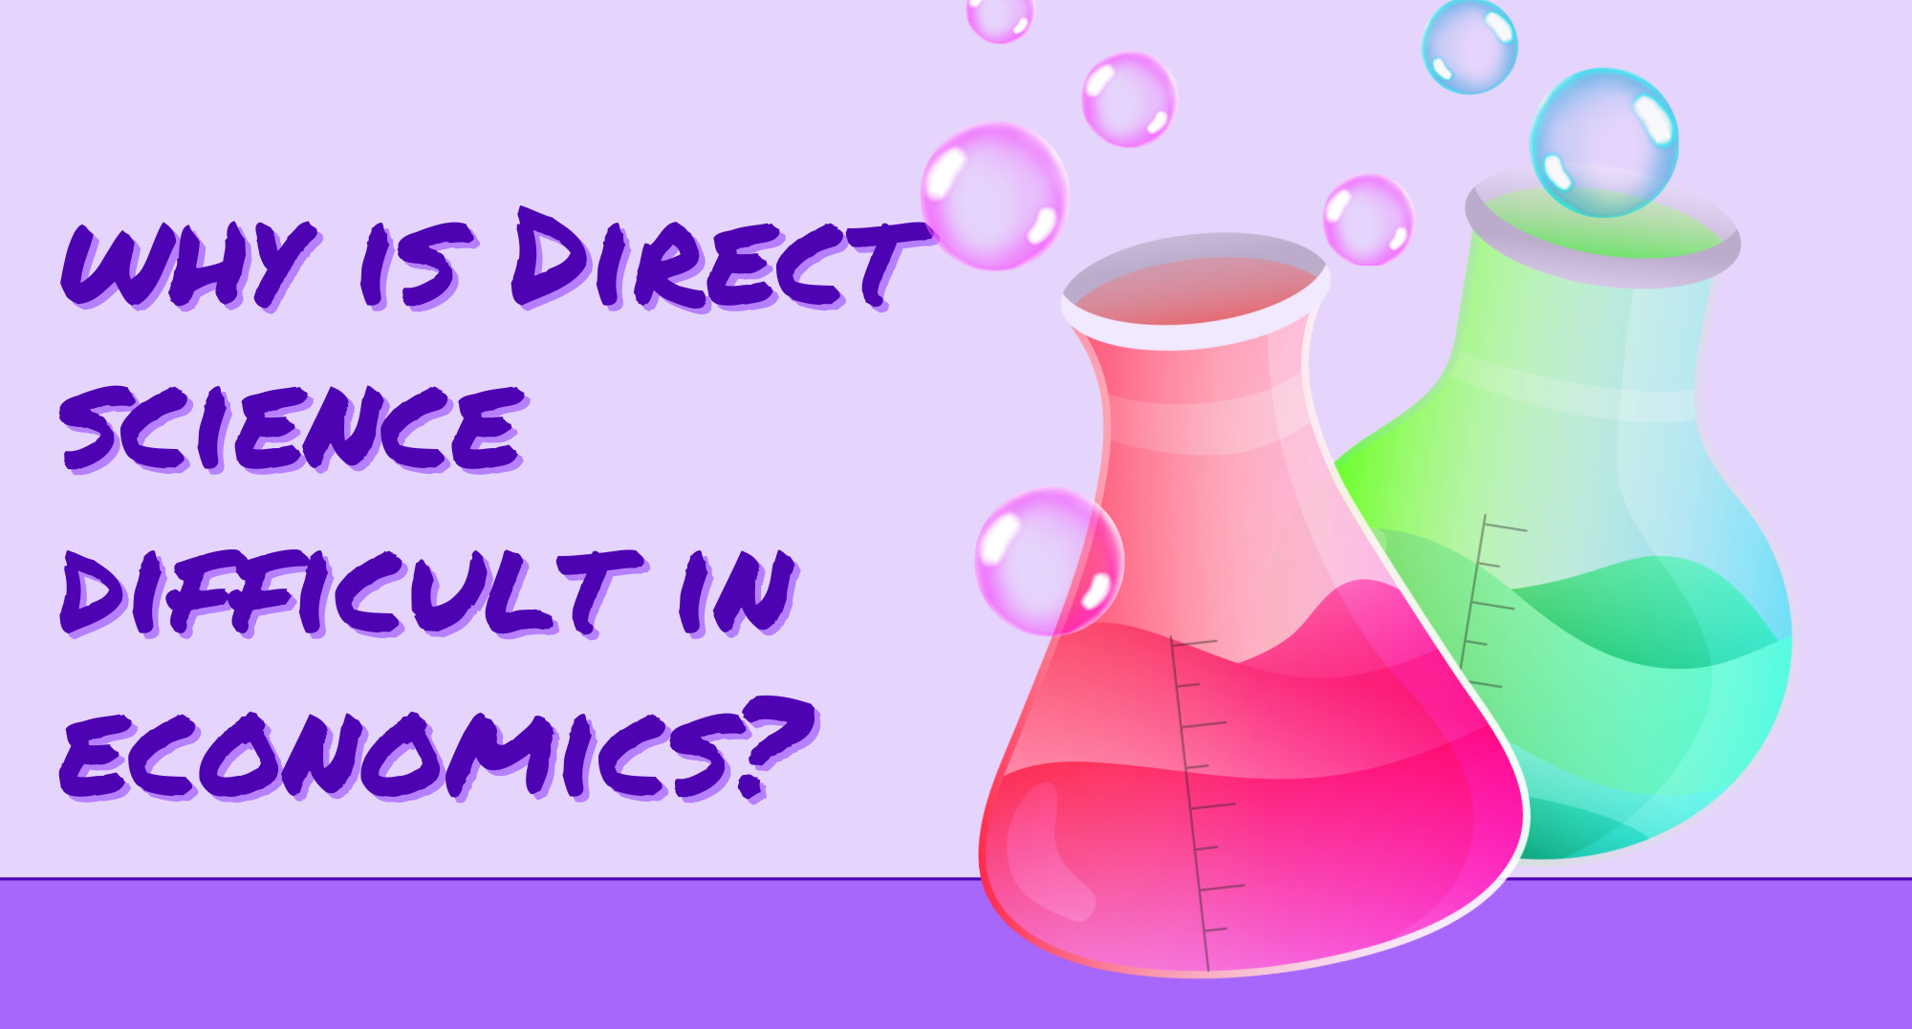

Slide 26
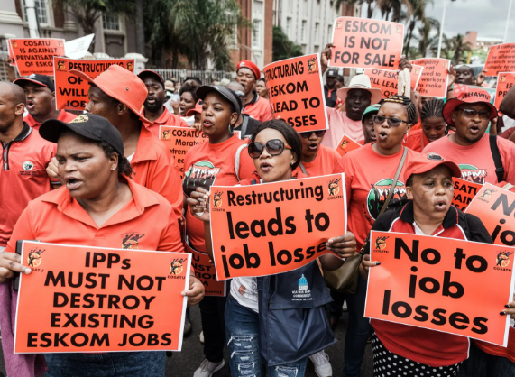
Why direct science is difficult in economics (slide 1 of 2)
Real world life is complex and the ‘Ceteris Paribus’ challenge is virtually impossible to hold all things constant
Ethical issues, as economists should not change variables in people's lives for experimental purposes
For example imagine dramatically increasing unemployment to see what would happen to wage values

Slide 27
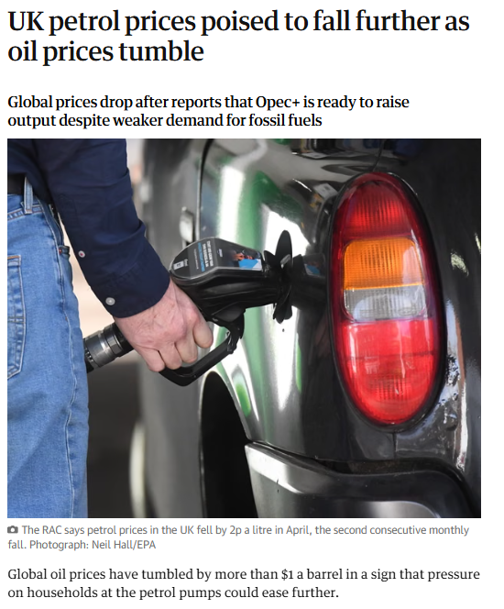
Why direct science is difficult in economics (slide 2 of 2)
Consumer behaviour is not always rational or predictable and when humans are aware they are being watched they will act differently
Time delays, for example we have seen in the news in the past with prices of oil per barrel reducing, this can take months before the price changes are seen or felt at petrol stations

Slide 28

Mini plenary quiz – which of these are REAL reasons why direct science is difficult in economics?
Time delays
Consumer behaviour is unpredictable
Ethical issues
Real world life is complex
Impossible to hold the ceteris paribus challenge
Time is constant
Consumers want many products
Environment
Real world is hard
Ceribus is hard to do
Notes:
Answer 1-5 are correct 6-10 are all fake

Slide 29
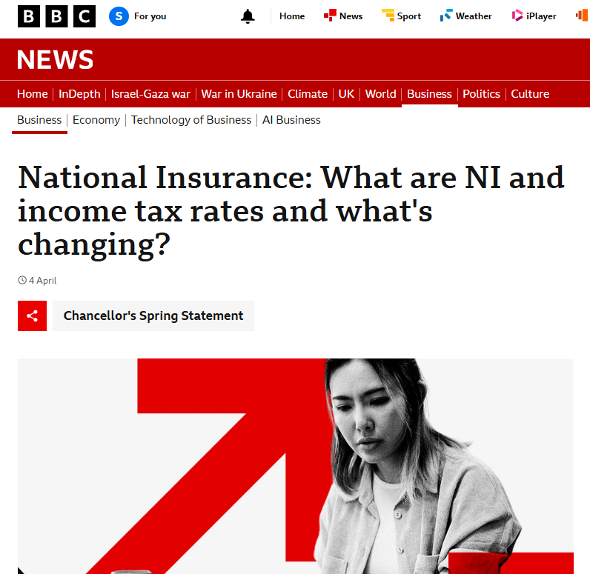

Activity: Natural Experiments
Look at this news story from when the UK government increased the National Insurance contributions from business
Discuss assumptions and hypotheses that you can make from this news article
Be prepared to share your ideas
Notes:
1- https://www.bbc.co.uk/news/explainers-63635185
Suggestions
1- Businesses will cut costs and therefore unemployment will increase
2- Business spending will go down and therefore investments from industry would fall
3- allow any other acceptable answer
Is it a fair assumption and hypothesis to assume that when the Government increase national insurance contributions for businesses this will increase their costs and as a result will lead to industry making staff redundant or lowering their recruitment rates, this will result in UK unemployment rate to increase.

Slide 30

Plenary quiz questions
Decide if these statements are TRUE or FALSE
Opportunity cost is the value of the next best alternative foregone
Life is complex and the ‘Ceteris Paribus’ Challenge is virtually impossible to hold all things constant
Economics is a social science that studies how limited resources are used to produce and consume goods and services.
By using theoretical models economists can make predictions of future events
Notes:
To be completed

Slide 31
Plenary quiz answers
Decide if these statements are TRUE or FALSE
Opportunity cost is the value of the next best alternative foregone TRUE
Life is complex and the ‘Ceteris Paribus’ Challenge is virtually impossible to hold all things constant TRUE
Economics is a social science that studies how limited resources are used to produce and consume goods and services. TRUE
By using theoretical models economists can make predictions of future events TRUE

Slide 32


Slide 33
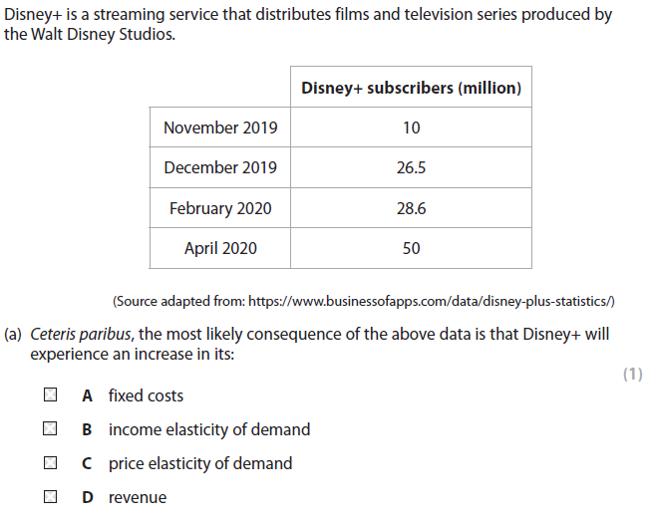
Sample question
This is an example question using the phrase ‘ceteris paribus’
Don’t worry about trying to answer this yet, the course has just begun and you will need to know more
It is important to see how it appears in exam papers

Slide 34
Sample question answer
The only correct answer is D
Why?
A is not correct because fixed costs are not related directly with output in the short-term
B is not correct there is no information available on income changes
C is not correct because there is no information available on price changes

